Slide 1
Synthetic Data 3 – Coarsening, Mimicking & Simulation.
Joseph Allen, Research Associate
1st June 2021
Copyright © 2021 UK Data Service. Created by Cathie Marsh Institute, University of Manchester
Notes:
Hello everyone and welcome to this UK Data Service Webinar, Synthetic Data part 3- Coarsening, Mimicking & Simulation
I am Joseph Allen, a Research Associate with the UKDS in the University of Manchester.
Thank you all for coming

Slide 2

Can you hear us?

Slide 3
Can you hear us?
If not:
Check your speaker/headset is plugged in / volume is on.
Click on audio to change to listening via phone
We are recording this webinar and will post it on YouTube (https://www.youtube.com/user/UKDATASERVICE)
Notes:
If you can’t hear us you can check your speaker and headset is plugged in
You can also listen in via phone on Zoom
We are also recording this webinar and livestreaming it to YouTube so you can always watch it later if something does go wrong.

Slide 4
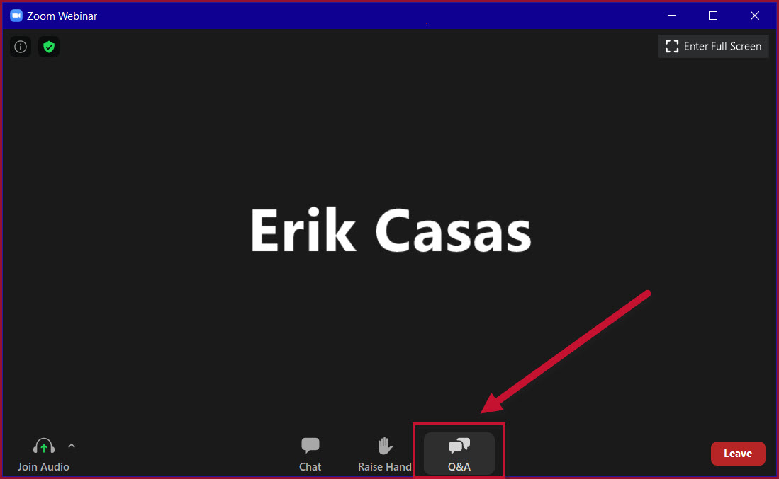
Have questions?
Click the Q&A tab.
Notes:
If you have any questions during or after this webinar, please click the Q&A tab along the bottom menu of Zoom.
Feel free to ask questions during the talk and a facilitator will try to answer swiftly.
Otherwise there will be time for questions at the end, so feel free to ask early and often.

Slide 5

Last time on Synthetic Data
Redaction – removal of rows or columns.
Masking - replacing data with new, fake data.
Notes:
In our last webinar we covered
Redaction - A disclosure control methods of removing entire rows, columns or parts of data and why this is appropriate.
Masking - A disclosure control method of replacing data with new, and fake data.
Photo by Stas Knop from Pexels

Slide 6
Webinar Overview
Disclosure Control - Coarsening and Mimicking
Simulation
The Synthetic data spectrum
How to Synthesize data - Libraries, decisions and steps.
Notes:
In this webinar we finally get to touch on the cool parts of this topic!
We start by finishing off Disclosure control, covering Coarsening and Mimicking.
Then we will dive into some case studies on simulation.
We will whizz through a spectrum of classifications for synthetic data
And finally, we will cover how to synthesize a dataset!

Slide 7
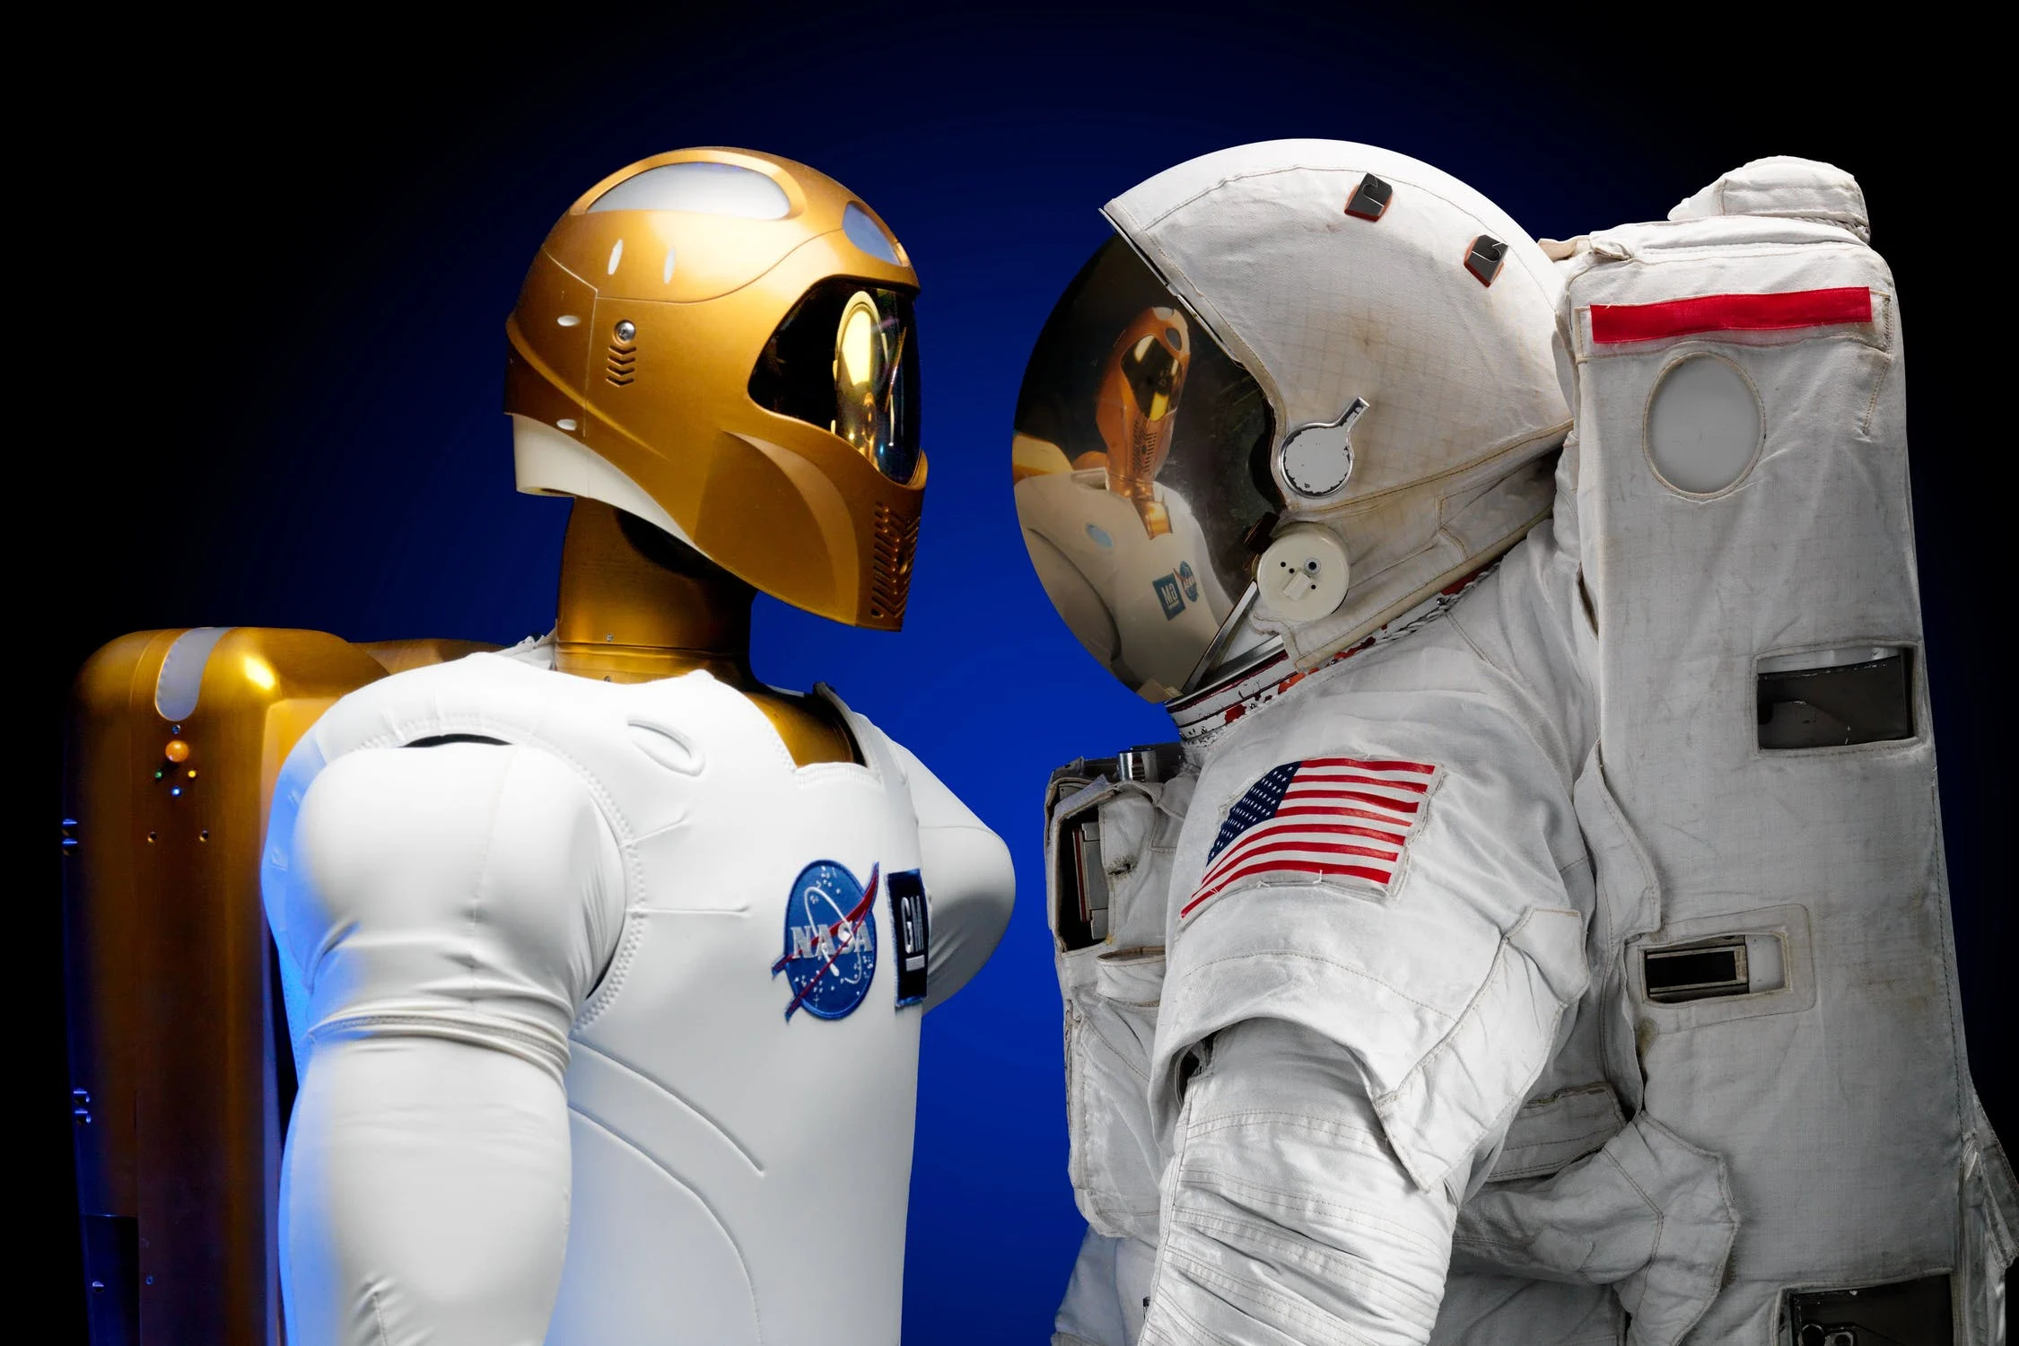
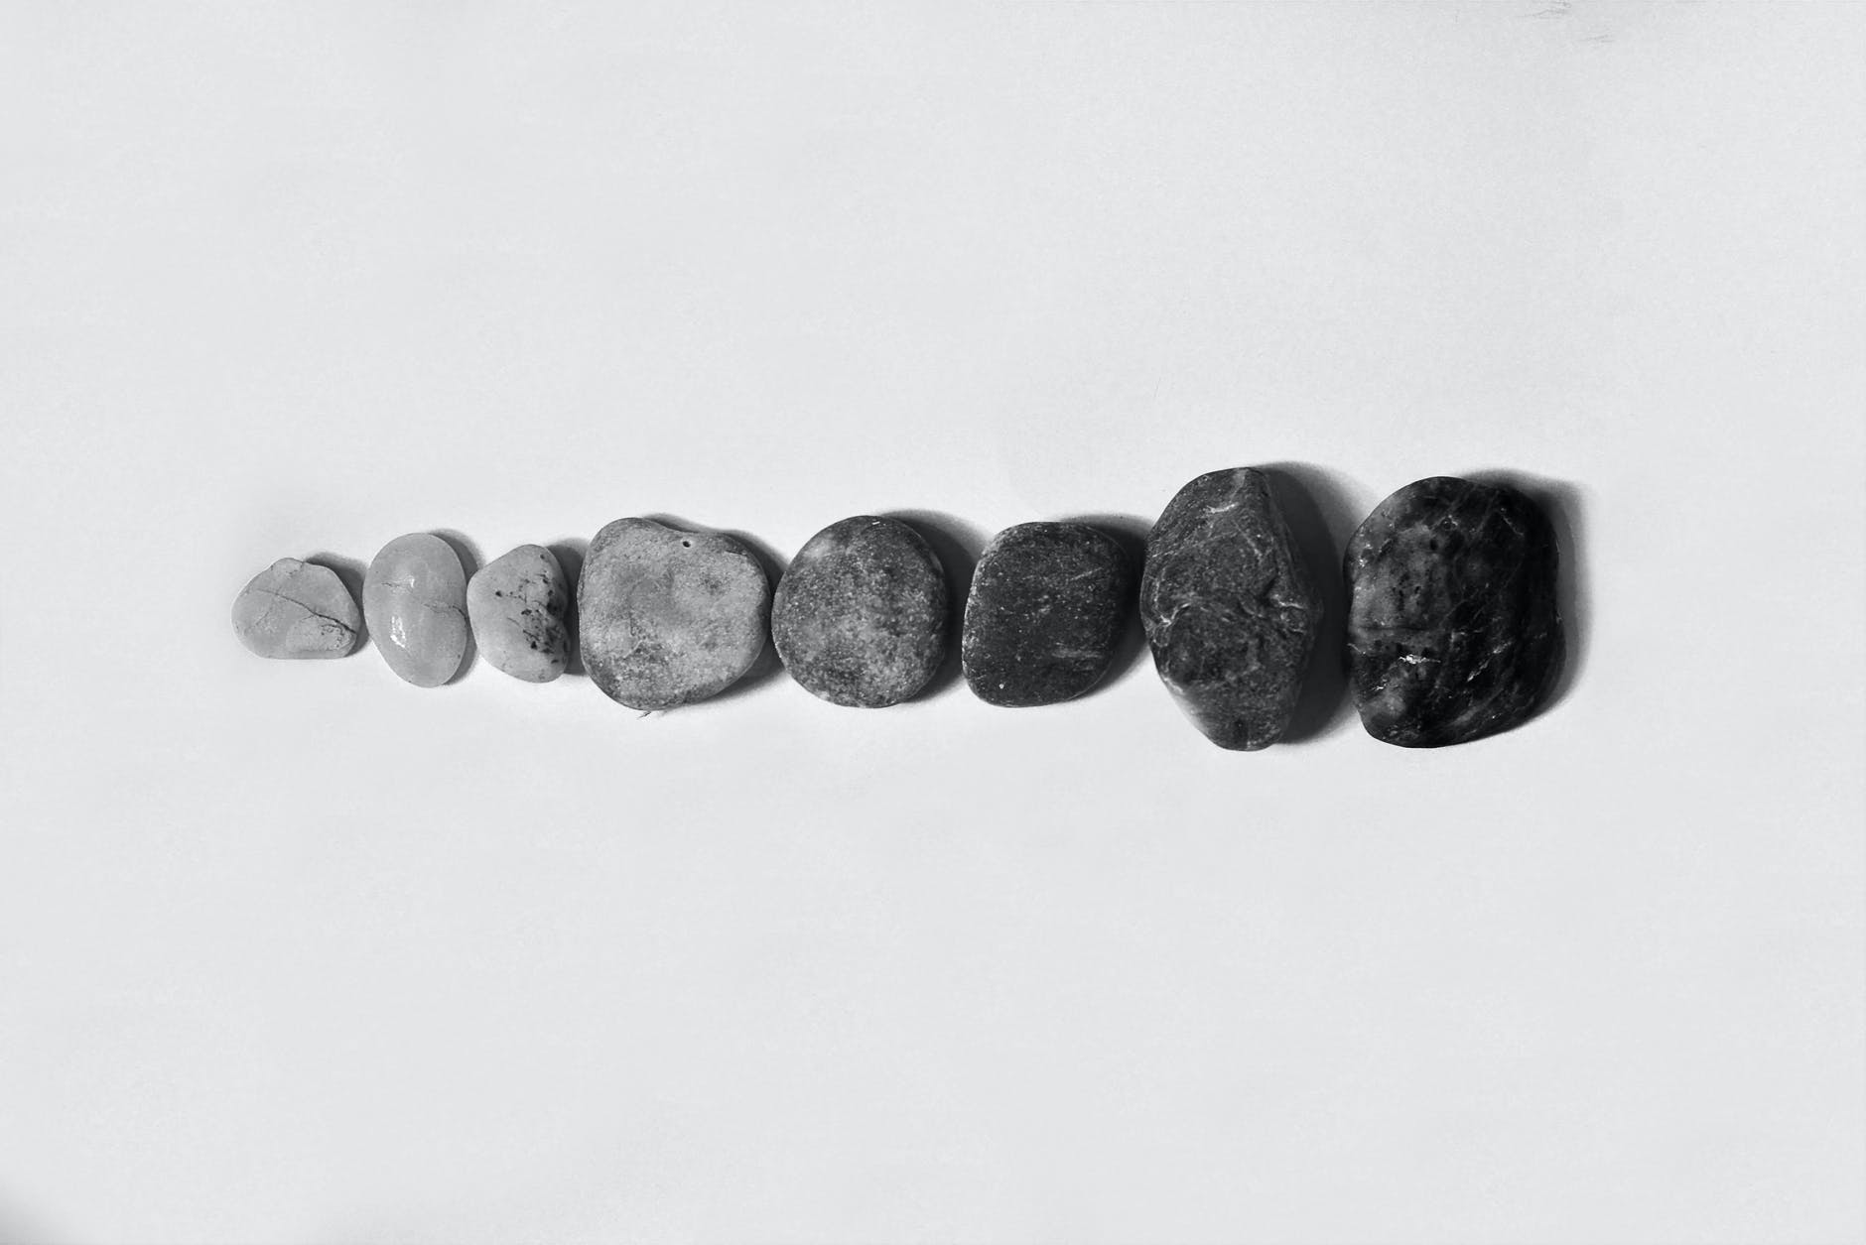
This time on Synthetic Data
Coarsening - reducing the precision of data to protect individuals.
Mimicking - generate a dataset that closely matches the real dataset but does not contain exactly the same entries
Simulation - generating part or all of the dataset that is similar in essential ways to the real data but is different with regard to sensitive information.
Notes:
In this webinar we cover the following methods.
Coarsening - This refers to reducing the precision of data to protect an individual. An example here might be reducing a birthdate to their current age, or age group. The more we coarsen the less correct our analysis becomes.
Mimicking - Generating a dataset that closely matches the real dataset without containing the same entries. This could be sampling from a dataset and adding some noise.
Simulation - This is data synthesis, here we build a model of what we know about the real dataset and use this to generate new data, whilst dealing with sensitive data separately. This requires a deep understanding of a dataset and its nuances.
I want to take this opportunity to point out how similar mimicking and simulation may seem. We could also combine these methods. We are on the fringes of an emerging topic and as such all these quirks have yet to be ironed out so if you feel these definitions are slightly fluffy don’t worry because I agree with you!
Photo by Anna Shvets from Pexels
Photo by Pixabay from Pexels

Slide 8
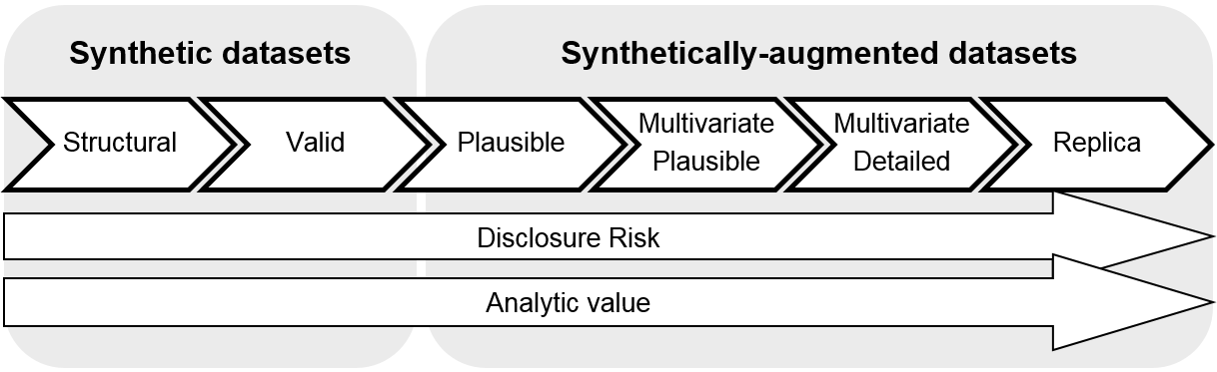
Synthetic data spectrum
As synthetic data becomes more real, it becomes more dangerous, and more useful.
Notes:
Before we discuss these various methods, I’d like to introduce the Synthetic Data Spectrum as provided by the Office for National Statistics.
The general gist of this diagram is that as a dataset becomes more realistic, it becomes more risky to make use of.
Also as it becomes more realistic, it’s analytic value increases.
We have discussed these trade offs in depth in the last two webinars. There are always going to be trade-offs between precision and the safety a dataset offers.
It is only with the context of the dataset we are working with, and the skills,money and time we are willing to invest to develop a synthetic dataset that we can make any decisions about where on this spectrum our data needs to be.
We will get into these specific definitions later.

Slide 9
Synthetic Data
Data generated by a computer simulation that does not directly measure a real-world event.
Notes:
Now we are 3 webinars in I think it’s worth going back to this initial definition of Synthetic data we started with.
Data generated by a computer simulation that does not directly measure a real-world-event.
With the ONS propositions, synthetic data likely does not contain any personal data as it’s based of public understandings of a datasets structure and realistic guesses at distributions.

Slide 10
Disclosure Control
Methods to protect the confidentiality of the subjects of research.
Notes:
Let’s also look again at disclosure control, these are methods which protect the confidentiality of subjects of research.
Again quite an academic look on a topic that I argue is much, much larger than the world of academia.
This ONS data spectrum doesn’t cover dealing with disclosure control, though I think these two topics move together quite tightly, working together to solve the problem of confidentiality in useful datasets.

Slide 11
Disclosure Control - Coarsening
Notes:
So next, let’s cover Coarsening as a method of disclosure control.

Slide 12
Coarsening
Reducing the precision of data to protect individuals.
Notes:
Coarsening can be defined as reducing the precision of data to protect individuals.

Slide 13
Case Study - Address
ID | first_name | last_name | email | gender | address
0001 | Joseph | Allen | jallen@123.com | M | 10 Pawling Center, M3 6GA
Notes:
Say our research question is “what gender are the individuals of Manchester”
To some people the postcode M36GD doesn’t even mean Manchester, and we don’t need this level of precision.
There is potentially dangerous information here. Even though we have masked everything else about this individual, we appear to know where they live. If this dataset contained criminal activity, health data, finance data we could still be putting this individual in real danger.
So we need to keep some notion of this location, but to what extent?
We have multiple coarsening options here, depending on your research question.
We need to choose a small enough area, that the other records in that area help protect each individual.
But we also need granularity, appropriate for our research question.

Slide 14

Case Study - Addresses
66 Pawling Center, M3 6GA
Pawling Center, M3 6GA
M36G
M3
Manchester
Notes:
Some options we have are to :
We could Randomise the street or apartment number. This could perhaps be called masking.
We could Remove the street number altogether. Here we are coarsening, as we are reducing the precision of our data.
We could Remove the street name
We could Remove part of the postcode
We could even Remove the postcode entirely.
Photo by Florent B. from Pexels

Slide 15

Address Precision
What if we take it further?
West Midlands
United Kingdom
Europe
Earth
Notes:
We could even go further than this.
What if we aggregated by County, country, continent or even planet?
At some point this gets ridiculous, but it’s only with the context of our research question we can justify having an address at all!
Photo by Pixabay from Pexels

Slide 16
Case Study - Coarsened
ID | first_name | last_name | email | gender | address
0001 | Joseph | Allen | jallen@123.com | M | Manchester
Notes:
For the purpose of this study, all we need to know is which rows are Manchester data, and drop any that aren’t.
So now let’s answer our research question, “what gender are the individuals of Manchester”
100% male, not a great study but I have been somewhat protected now my address isn’t part of that study.

Slide 17
Weights and Heights
Student ID | Weight(kg) | Height(cm)
1 | 51 | 127
2 | 59 | 132
3 | 45 | 116
4 | 52 | 116
5 | 61 | 143
6 | 64 | 142
Notes:
In another quick example, let’s assume we have a small dataset of student IDs, and their corresponding Weights and Heights.
Our goal with this dataset is simply to answer “Does Weight correlate with Height in this student population?”

Slide 18
Weights and Heights- Coarsened
Weight to the nearest 5kg
Height to the nearest 5cm
Student ID | Weight(kg) | Height(cm)
1 | 50 | 130
2 | 60 | 130
3 | 45 | 120
4 | 50 | 120
5 | 60 | 140
6 | 60 | 140
Notes:
What I’ve done here is rounded the weights to the nearest 5 kilograms, and the heights to the nearest 5cm.
This is definitely better in terms of protecting individuals as they may know their height to this precision and if the school or class information is known they could be identifiable.
For example the lightest person in this class, might still recognise their record, student 3, because they are still the lightest.
Similarly Student 4 might know they are the shortest, but not the lightest.
In a larger dataset, this would be enough to protect each individuals.

Slide 19
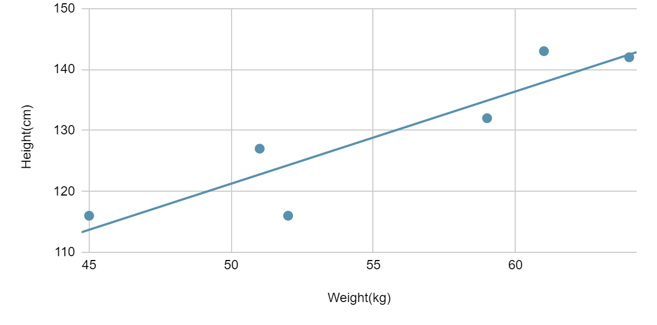
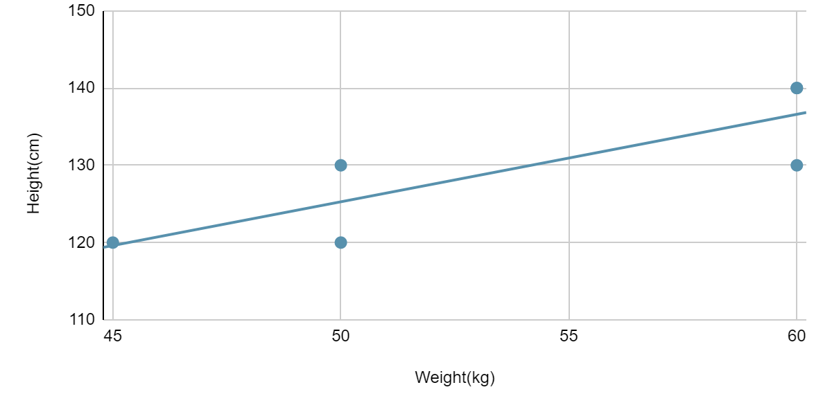
Weights and Heights - Correlation
Lost precision.
Both strong and positive correlation.
Original
Coarsened
Notes:
When we plot this data we can see the impact this would already have on a linear model.
We have lost precision, you can see all points in the Coarsened dataset landing exactly on multiples of 5 kilograms or 5 centimeters.
We can also see we have decreased the gradient in the line of best fit relating these two variables.
We can still, at least, claim that weight and height has a positive correlation, but depending on the algorithm used we may have really harmed our analysis here.
Regardless, we can still answer our question “Does Weight correlate with Height in this student population?”
Yes, Yes it does!

Slide 20

Synthesis Techniques - Coarsening
Aggregation
Mean
Total
Notes:
We can also aggregate column, or group similar rows where it makes sense to do so.
We could do this by:
Means over columns, such as average weights per age
Totals, this could be useful to broadcast populations over regions
Photo by Soner Mazlum from Pexels

Slide 21
Disclosure Control - Mimicking
Notes:
Great, next we move on to Mimicking. Very closely related to Simulation but more reliant on real data.

Slide 22
Mimicking
Generating a dataset that closely matches the real dataset but does not contain exactly the same entries.
Notes:
Mimicking can be defined as
Generating a dataset that closely matches the real dataset without containing the same entries.
This could, for example,be sampling from a similar dataset and applying other disclosure control methods.
Again this is not data synthesis, perhaps because we are making use of real data and piecing that together, rather than understanding its distributions and truly synthesizing something new.

Slide 23
Sisters – The dataset
Sample our rows
Add variance to ordinal and numeric data
Student ID | Average grade | Number of sisters
1 | B | 1
2 | A | 2
3 | A | 16
4 | B | 3
Notes:
So in our last webinar we had a dataset of students, their average grade and a number of sisters. With this dataset we explored the question “Does the number of sisters a student has, influence their average grade”.
To mimic this dataset we can repeatedly sample these rows,
We can add a random amount to each grade and number of sisters
And through this process, similar to coarsening, we might lose a little precision.

Slide 24
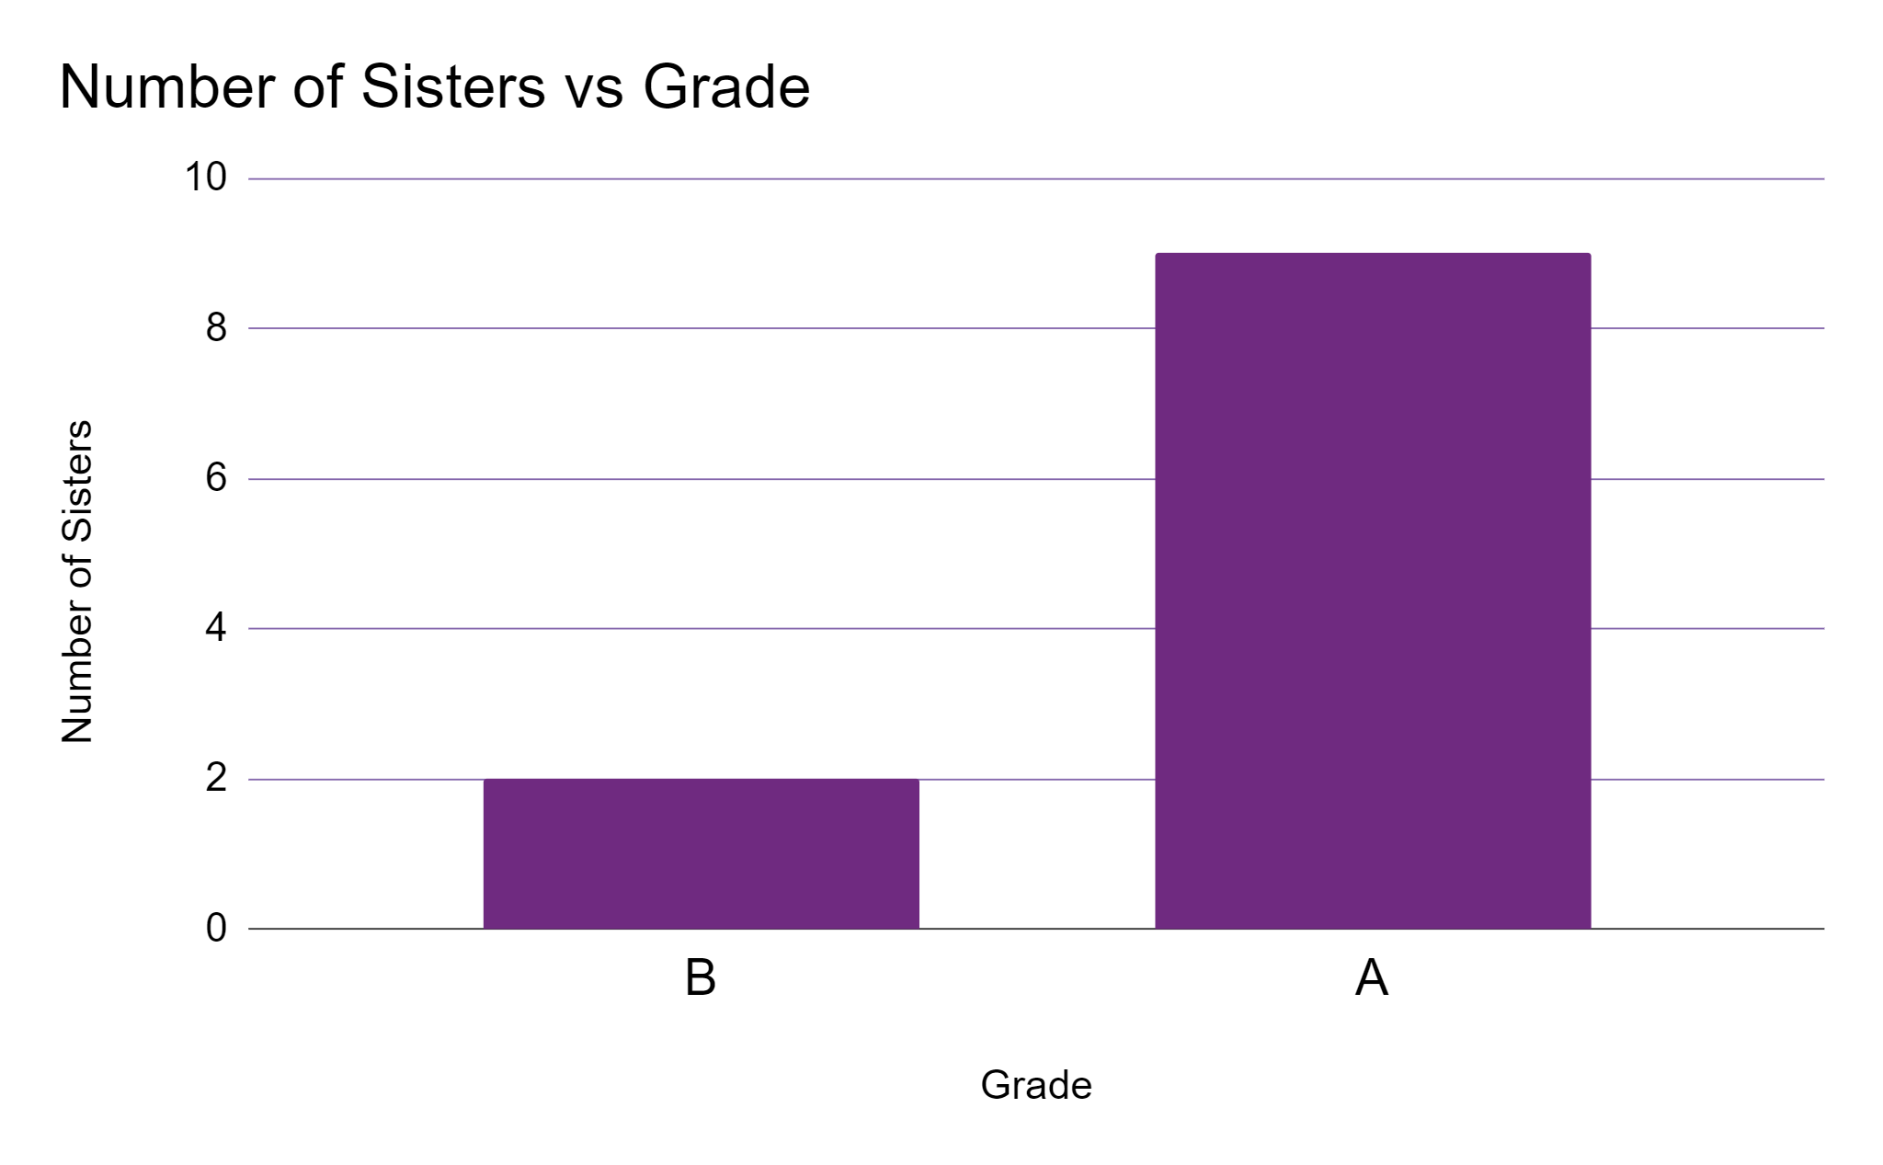
Sisters - Correlation
Notes:
So taking the aggregation of the mean number of sisters per grade, we can see that there does seem to be a positive correlation between these variables. That is to say that the more sisters a student has, the better their grades in this small sample.

Slide 25
Synthesis Techniques - Mimicking
Student ID is not protected
Did we protect our outlier?
Student ID | Average grade | Number of sisters
1 | C | 0
2 | A* | 3
3 | B | 15
4 | A | 2
Notes:
So what I’ve done here is sample our entire dataset, and i’ve added some noise of up to one grade, or one number of sisters difference.
Student 1 lost a grade and lost a sister for example.
By keeping these student IDs we can see how our sampling worked, but in a real-application we need to re-index these quite clearly.
Also, looking at our outlier student who had 16 sisters, this variance of plus or minus one sister hasn’t done much, they are still the outlier, identifiable as the student in this dataset with the most sisters.

Slide 26
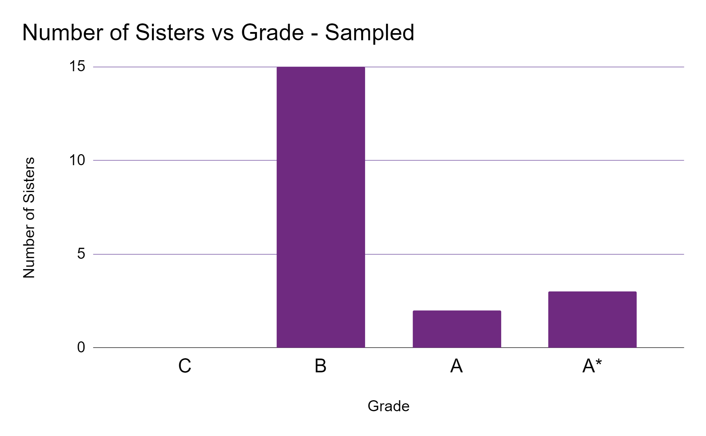
Sisters - Mimicking
Notes:
When we compare the sampled values here we have sort of flipped our relationship.
Yes at the higher grades there appears to be correlation, but in our sampling our student with the most sisters dropped from an A grade to a B, and our student with 2 sisters got an A.
This raises the question, how much randomness is too much. In this case changing an entire grade can randomly flip our entire relationship, it’s too much.
Perhaps instead adjusting only the number of sisters is enough.

Slide 27
Resampling the sisters
Larger dataset
Student ID | Average grade | Number of sisters
1 | B | 0
2 | A | 3
3 | A | 17
2 | A | 2
3 | A* | 15
4 | B | 2
Notes:
And now we are talking about Mimicking, we can for the first time grow our dataset.
Nothing says we can only sample the dataset as many times as we have rows
Instead we can continue sampling, and get repeats, but through the addition of noise we get clusters of similar students. In a larger dataset this would be quite useful.
We can also see that with the second time we sampled student 2, our randomness didn’t change their record at all, in a larger dataset this might be okay but it’s always case-by-case.

Slide 28
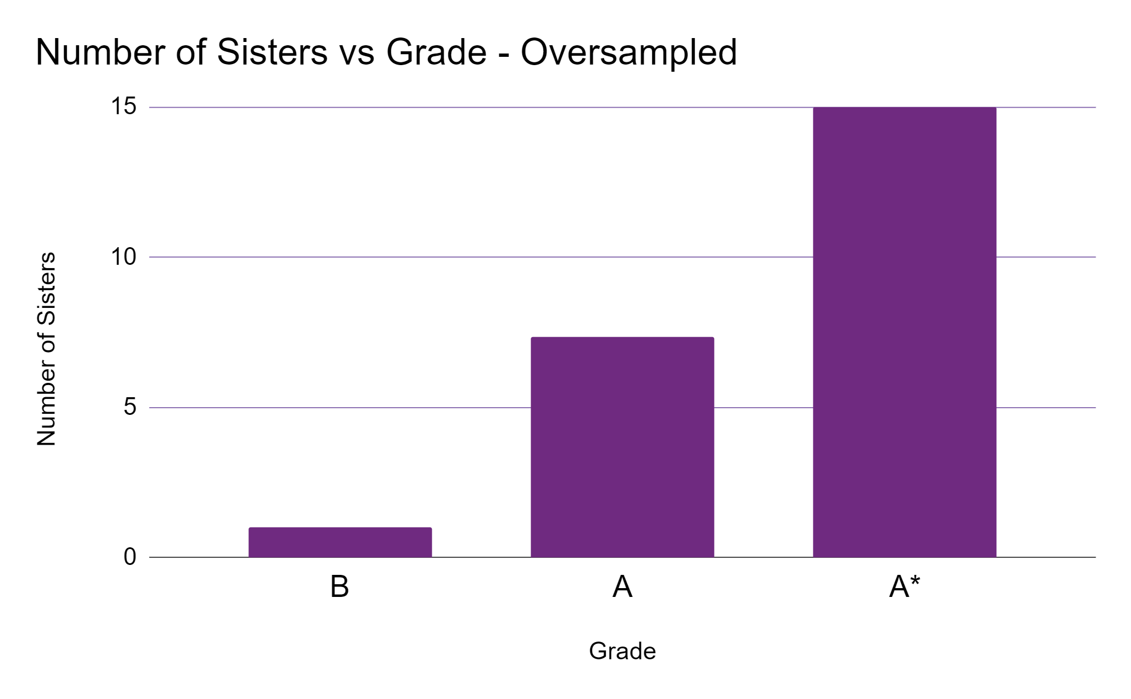
Sisters - Sampled
Notes:
This time I have oversampled the data, and only added some noise the the number of sisters themselves, not the grades.
We can see here what is essentially clusters of random results around each data point we did have.
Our relationship here looks somewhat clearer, but at the same time we have enhanced just how real this relationship is. Really I would suggest a much larger dataset before we apply something like this, the purpose isn’t to create data around our points, but to make use of that private data in a safer way.
Simulation will instead solve both of these problems.

Slide 29
Simulation
Generating part or all of the dataset that is similar in essential ways to the real data but is different with regard to sensitive information.
Notes:
So that has lead us on nicely to Simulation, finally we are talking about creation of new data rather than disclosure control and this is where we are really talking about Synthetic data.
Simulation can be defined as
Generating part, or all of the dataset that is similar in essential ways to the real data, but is different with regard to sensitive information.

Slide 30
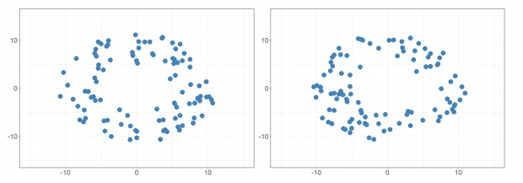
Sounds like Mimicking?
Simulation - Generating part or all of the dataset that is similar in essential ways to the real data but is different with regard to sensitive information.
Mimicking - Generating a dataset that closely matches the real dataset but does not contain exactly the same entries.
Notes:
I think here it’s important that we highlight how similar these sound.
The major difference here is that simulation is generating entirely new data, with an understanding of the essential properties of the original data
Mimicking on the other hand is pulling from the original data, and adding something for the sake of confidentiality.
In this image on screen, both techniques could generate the new dataset on the right, from the left. But only the simulation method would technically be synthetic data. Both retain the structure of the original data, but are not the same data.
https://dataingovernment.blog.gov.uk/2020/08/20/synthetic-data-unlocking-the-power-of-data-and-skills-for-machine-learning/

Slide 31
Simulation vs Mimicking
Simulation | Mimicking
Machine Learning, Data generation library or heuristics. | Sampling with noise.
Model can be separated from personal data. | Copies real data.
Replicates our understanding, tweaks and assumptions. | Replicates the sampled data.
Outliers represented, or oversampled. | Outliers may be missing.
Can synthesize new data, without a real input. | Requires access to the dataset at all moments of sampling.
Notes:
So to quickly summarise
Simulation can make use of basic random number generation, simple heuristics, machine learning algorithms, data generation libraries and similar. Mimicking on the other hand is essentially sampling, perhaps with some disclosure control methods added. The outcome of these may be indistinguishable without some high-level analysis.
In simulation we can add in logic, or not process explicitly personal data. Mimicking will simply sample these rows and may add noise.
Simulation is much more technical, and requires us to really understand our problem to simulate realistic data. Mimicking will sample that data, it’s bias and make a lot of assumptions for us.
Simulation can happen at a huge scale, and we can even intentionally overrepresent our outliers through methods such as oversampling. In mimicking we could, statistically, miss our outliers entirely.
Finally, a simulation can exist on it’s own. A simulation doesn’t need the original million row database, to create a new one. Mimicking does, mimicking is coupled with the dataset itself.

Slide 32

Rolling a dice
Notes:
So now we’ve covered simulation and mimicking, lets simulate some rolling dices, and see how this is different to mimicking a simulated dice.
Photo by Jonathan Petersson from Pexels

Slide 33
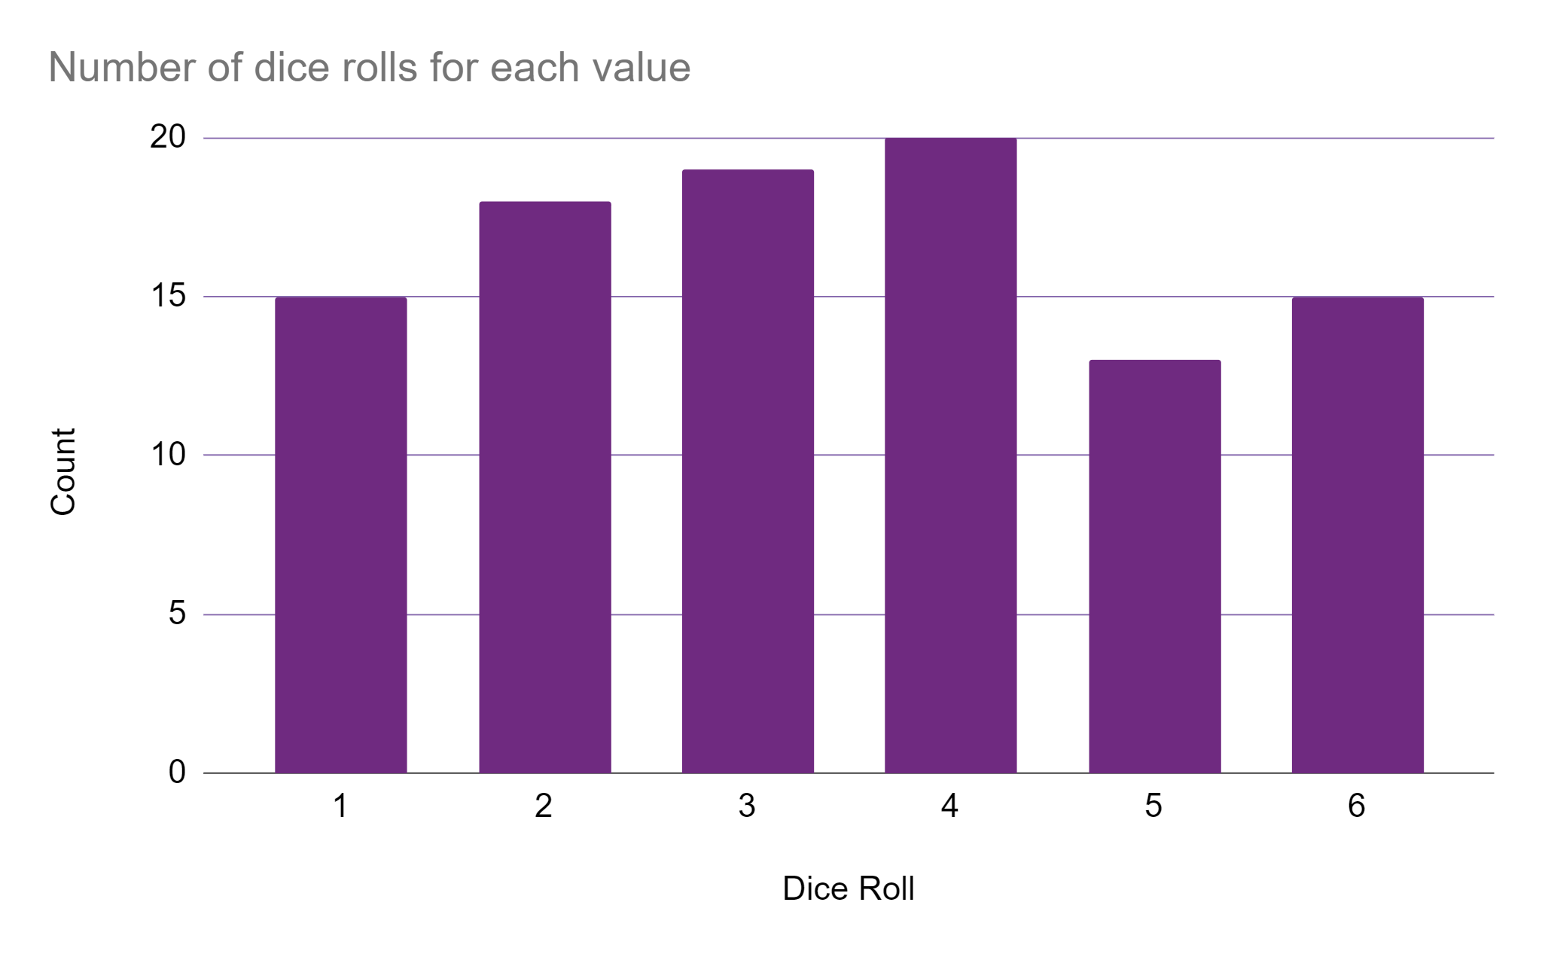
Dice Roll Collection
We have collected 100 dice rolls
Notes:
I have collected a dataset of 100 dice rolls.
We would expect about 17 instances of each result from 1 up to 6 in 100 rolls, but real life has some slight randomness here.
We can see 5 is underrepresented with only 13 rolls.
4 is overrepresented with 20 rolls.

Slide 34
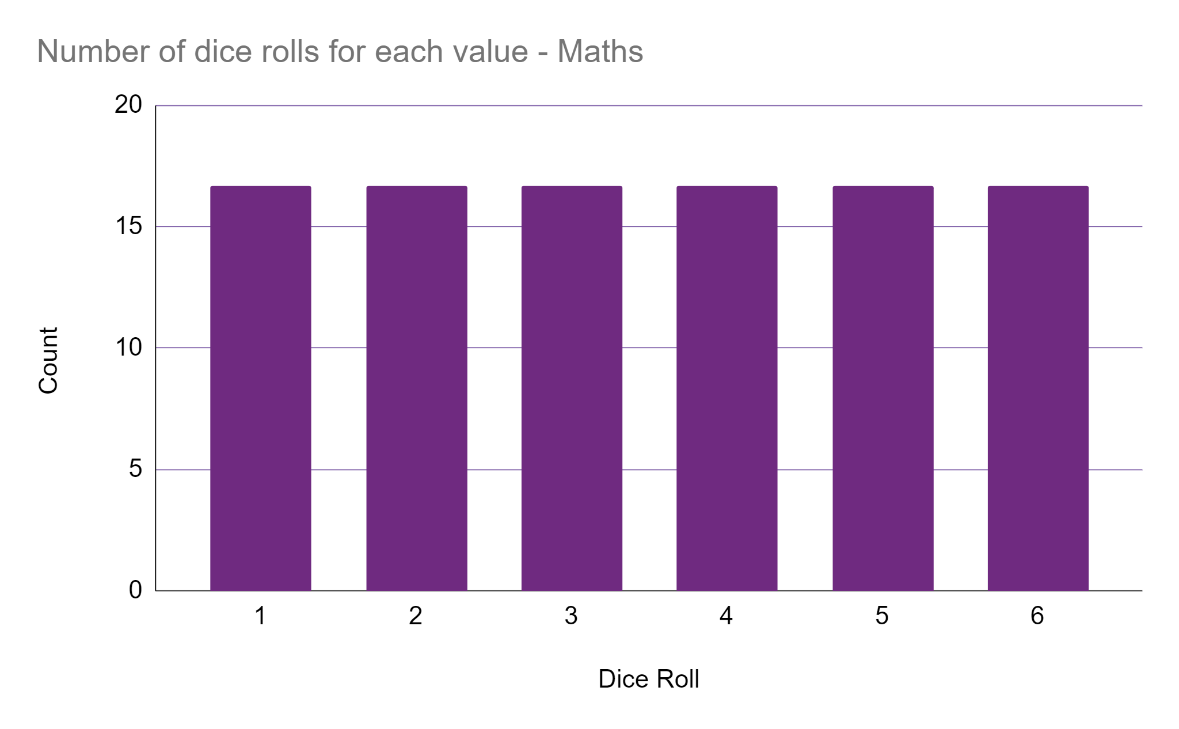
Uniform Distributions
We expect, and simulate a uniform distribution.
Notes:
Mathematically speaking in 100 rolls, we expect 16.7 instances of each outcome on a six sided dice. This uniform distribution looks nice, and closely represents how a dice should behave.
It might not behave this way depending on our sample size, it might also be that a real dice is not uniform due to weight distributions on the dice itself.
We expect, and simulate this uniform distribution, because we think that we know better than what the dice is telling us.
This uniform distribution is effectively our machine learning model we will be using to make predictions, only there is no machine learning involved in this simple case.

Slide 35

Models
A model is a system which takes some inputs, and predicts outputs.
Notes:
A model is a system which takes an input, and predicts an output.
This uniform distribution is effectively our machine learning model, only there is no machine learning involved in this simple case. We will randomly sample this uniform distribution to make “predictions” about a dice roll.
In the same regard if we were trying to predict the outcome of coin tosses, tossing a physical coin could be an effective model for any other fair tossed coin.
We can choose all sorts of different mathematical relationships to be the foundations of these models, and this is where machine learning algorithms can help us.
When we build a model we abstract a real-world situation, into something a computer can represent and recognize patterns from experiences.
Image Photo by Skitterphoto from Pexels

Slide 36
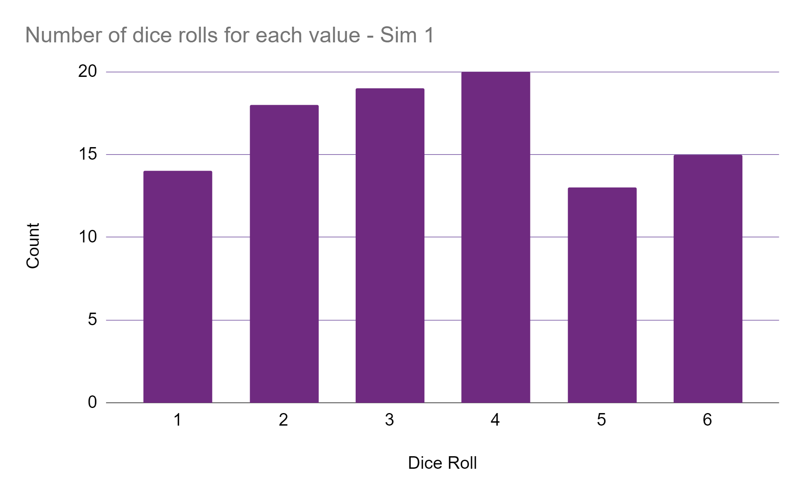
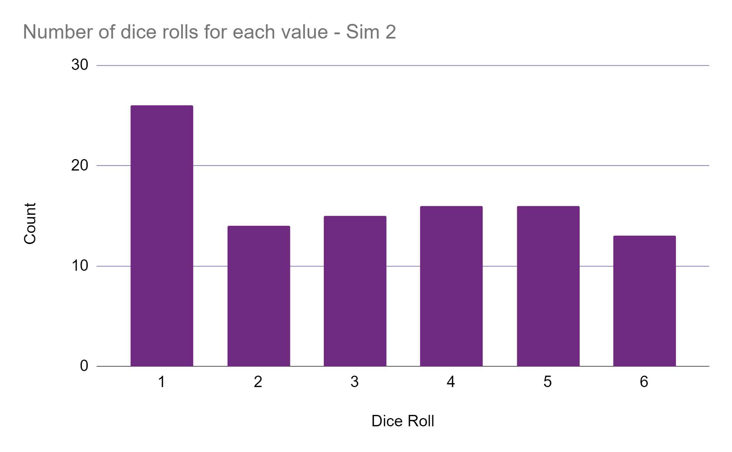
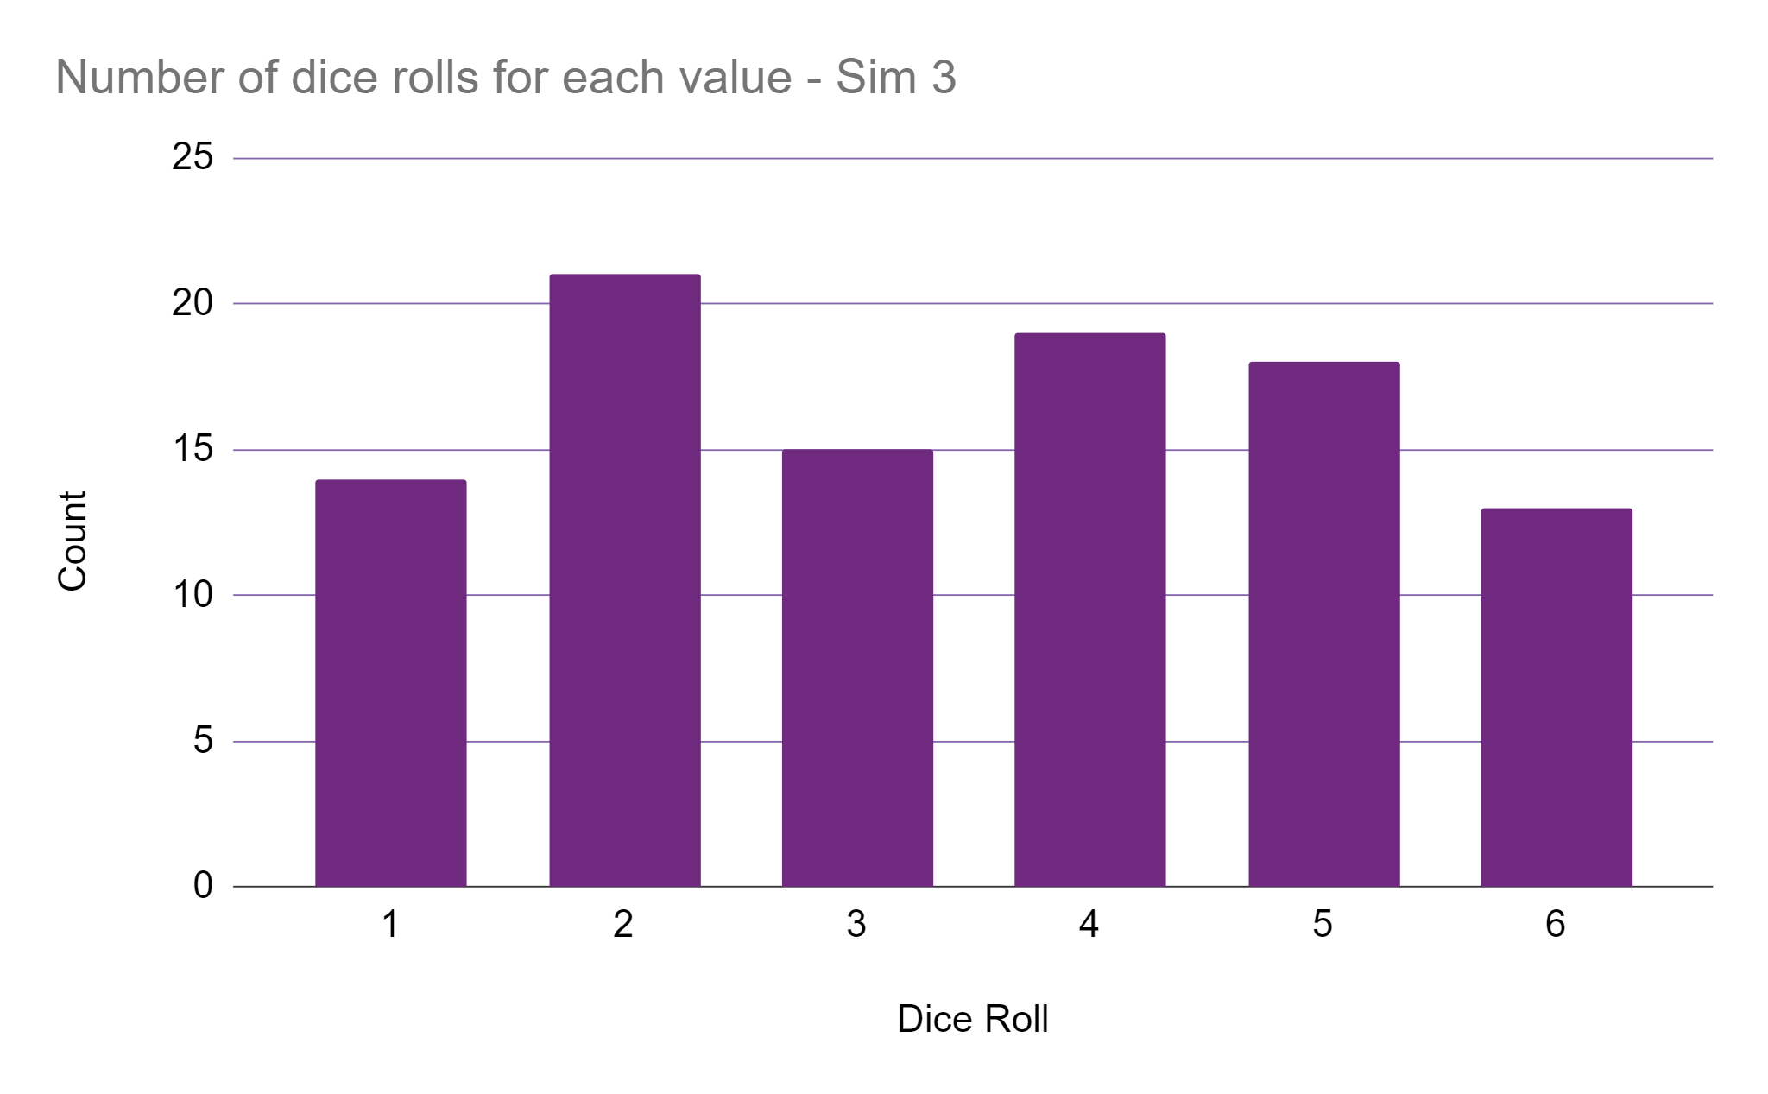
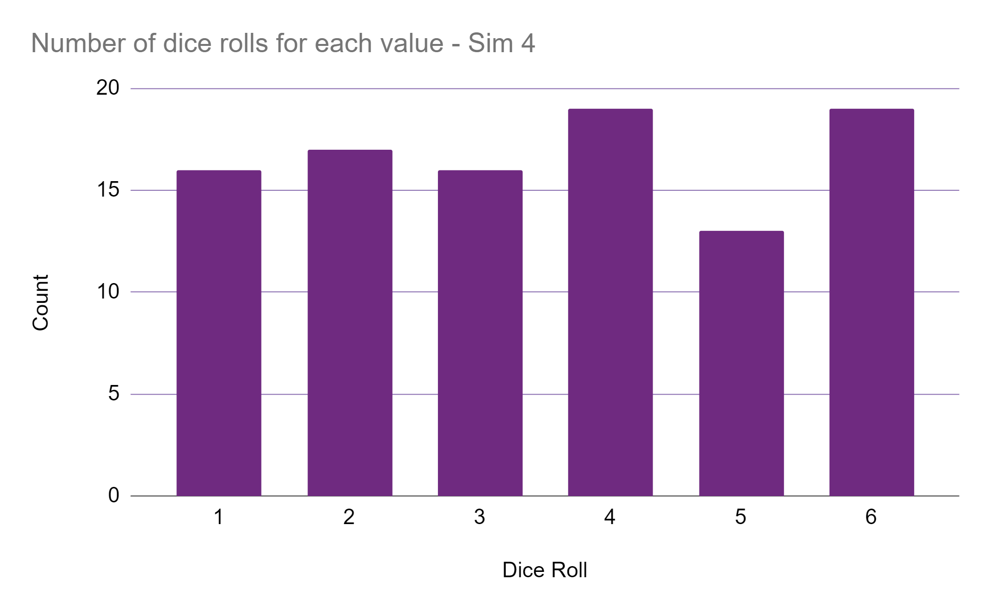
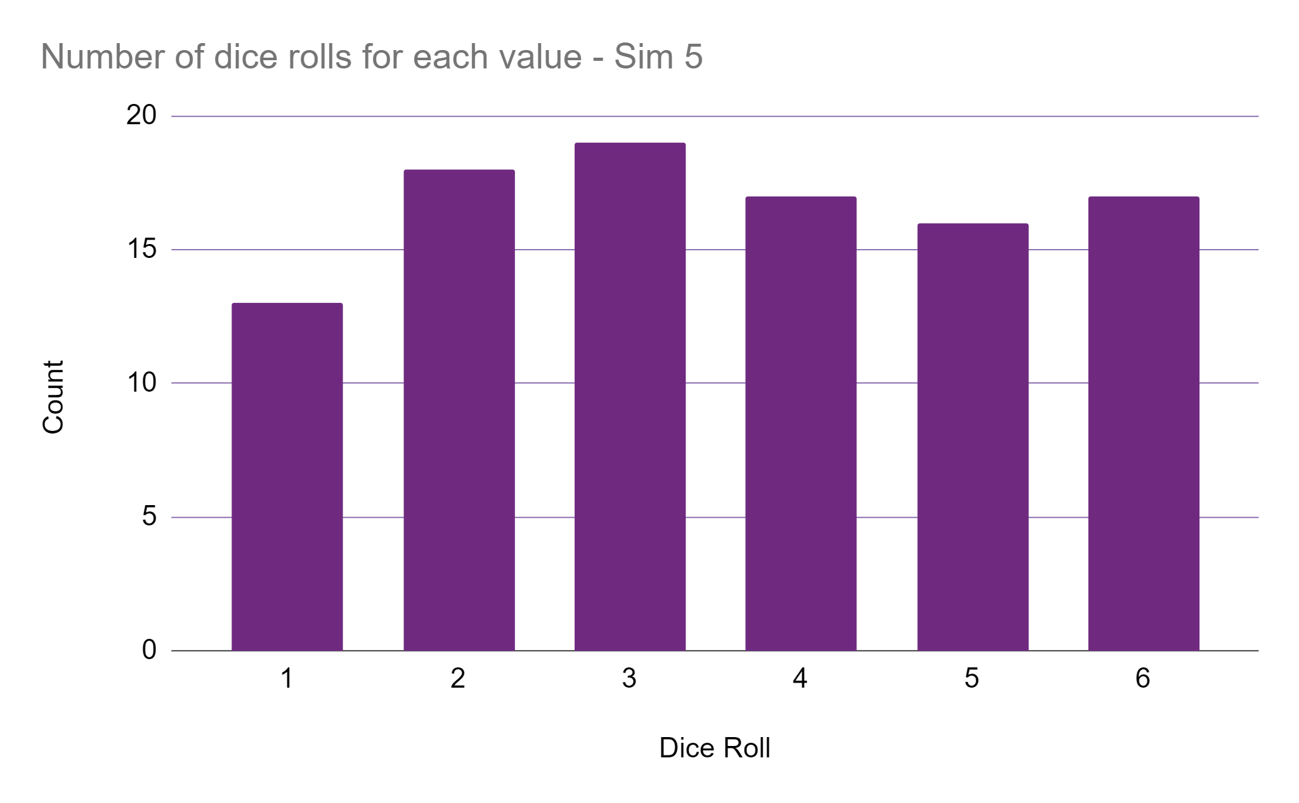
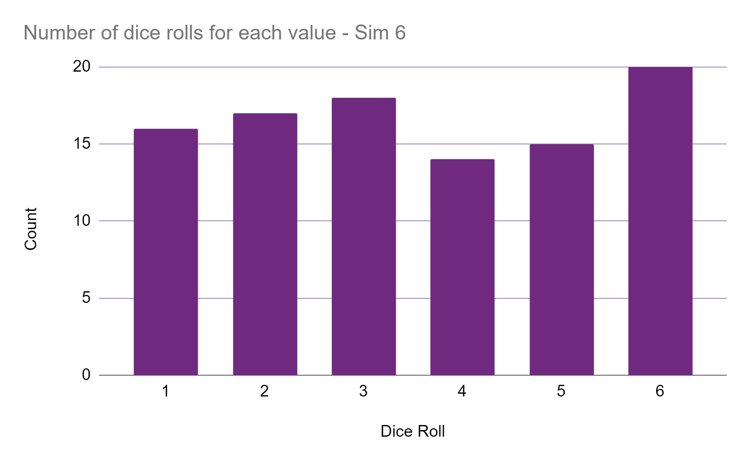
Dice Roll Simulations
Notes:
If we simulate those 100 dice rolls 6 times we can see that general shape of the uniform distribution is still there, but there are simulations where we deviate from this with differing amounts.

Slide 37
Perpetuating Bias
Simulating the left perpetuates the bias of the dataset.
Simulating the right perpetuates the bias of our understanding.
Notes:
Simulating the real data on the left , will perpetuate whatever bias that dataset has. So would mimicking.
Simulating the uniform distribution on the right will perpetuate the bias of our understanding, and again so would mimicking.

Slide 38
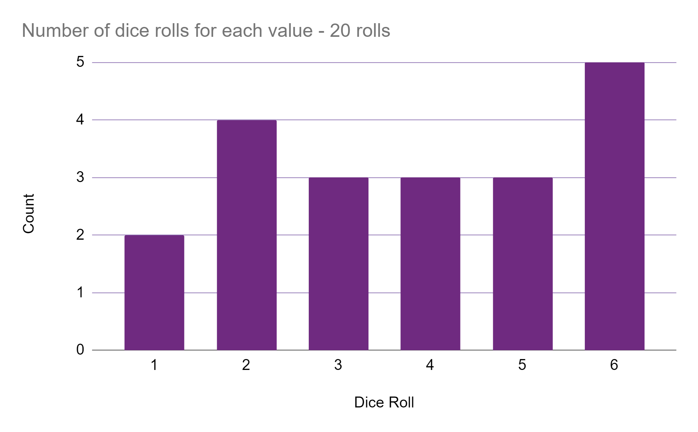
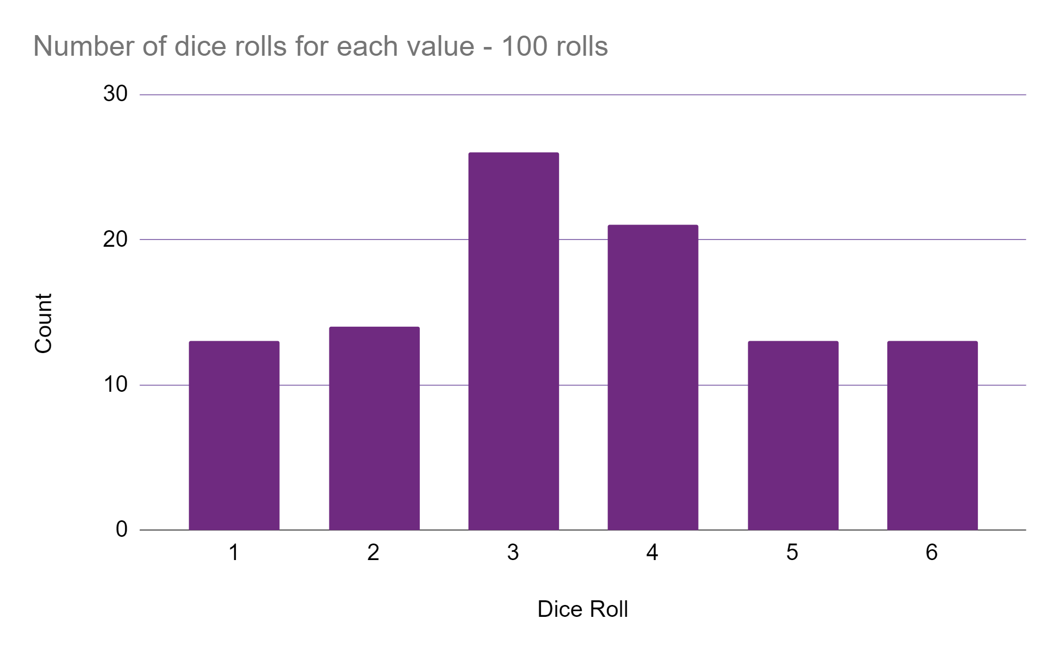
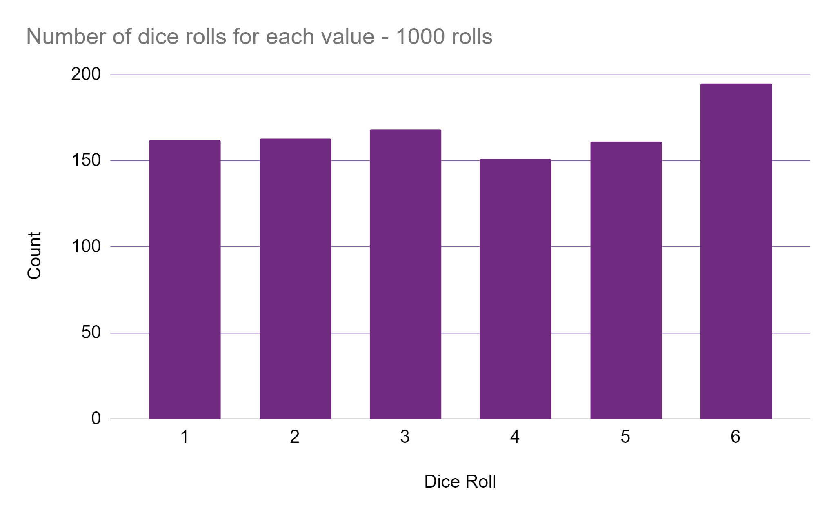
Sample Size
The more data we simulate the closer we get to our uniform distribution.
Notes:
We also find that the more values we synthesize or sample the close we get to the underlying relationship.
Here we have 20 rolls on the left, 100 rolls in the middle and 1000 on the right.

Slide 39
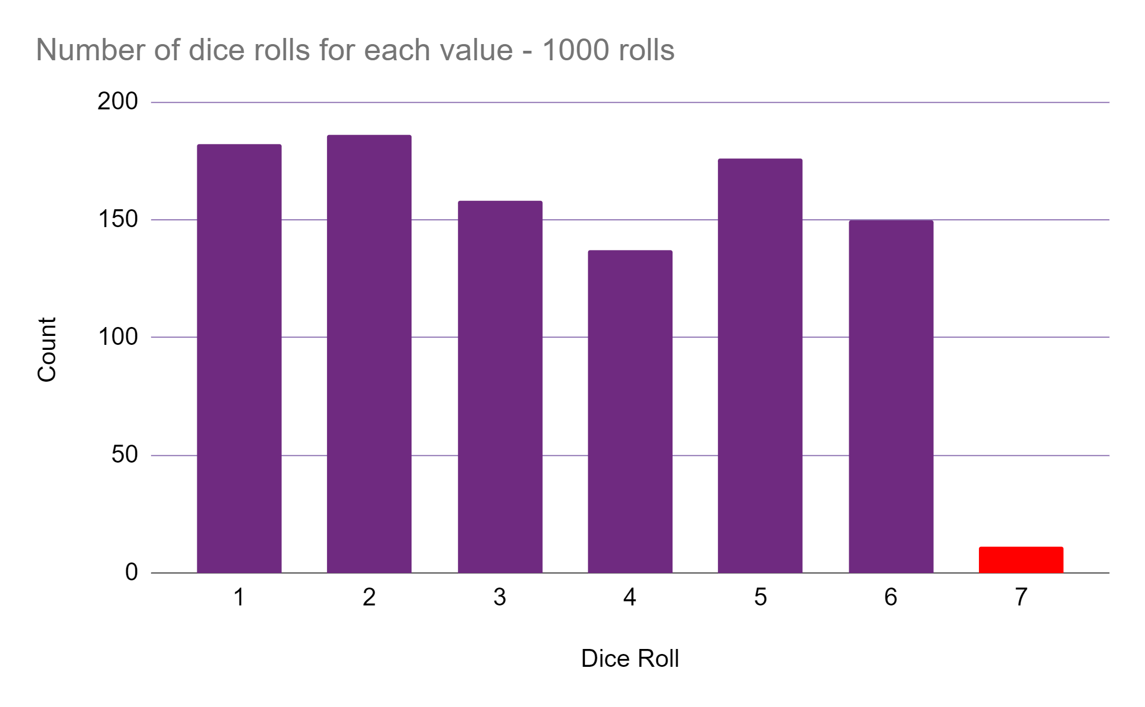
Bad Simulation
If our simulation made mistakes, it might be very obvious!
Notes:
If we rolled a 6 sided dice, and it somehow came up with a 0 or a 7 we would be understandably very confused!
In the world of simulation these edge cases can be possible with some bad maths, and would immediately reveal our simulation is not real data, so we have to carefully check these outputs still appear realistic.

Slide 40
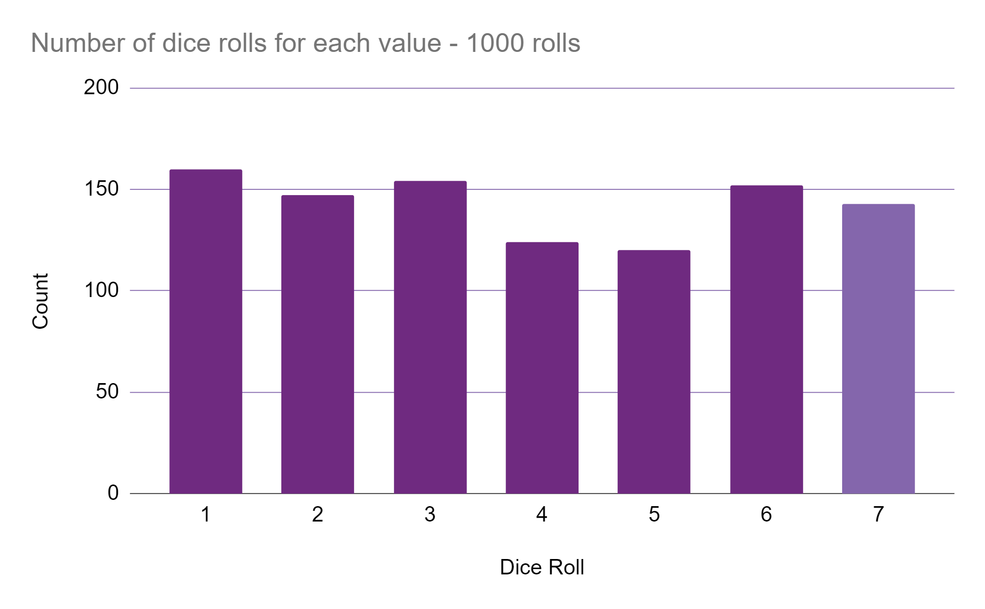
Adaptability
Simulating 7-sided dice is trivial.
Collecting 1000 new dice rolls takes time.
Notes:
Our simulated dice is also much more adaptable, if we realise we made a mistake and actually need to simulate a 7-sided dice over a 6-sided dice. This is a one-line code change.
In comparison, without our simulation the process of collecting this data involves: Finding an online retailer to source our dice from, much harder if it’s not a standard dice shape.
We need budget to purchase the dice
We need to wait for delivery from an online retailer
We need to dedicate time to the rolling and recording of said dice.
This is arguably days of passive and active work, in comparison to that one line code change we can generate data, and immediately dedicate that effort to analysing the data instead.
Also it’s possible that we can simulate dices that simply don’t exist

Slide 41

1000-sided Dice
Single line of code to simulate a D1000.
Notes:
What about huge dice, 1000 or 1 million sided dice. These may exist through combinations of other dices, but for our simulation this is just as complicated as upgrading from a 6-sided to 7-sided dice. Again one line of code changes.
This is where the data collection of the real-world situation in infeasible, and simple enough to abstract with our uniform distribution model.
Image source https://commons.wikimedia.org/wiki/File:W%C3%BCrfel,_Ikosaeder_(W20)_--_2021_--_5591.jpg

Slide 42
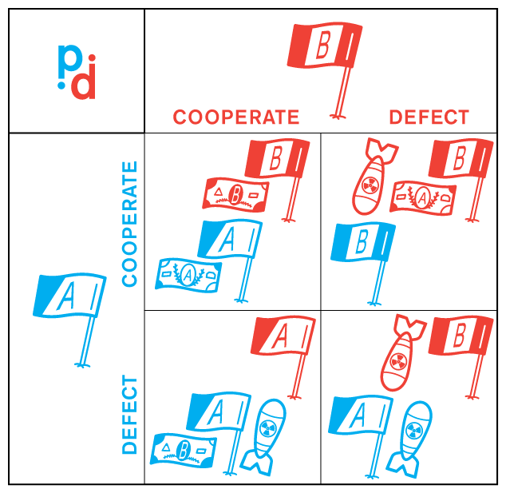
Agent-based modelling
Simulate agents, and restrict their environment.
Notes:
Another form of simulation is agent-based modelling.
In agent-based modelling we simulate individual agents, and restrict the things they can do within an environment. As always, it’s best to create some sort of abstraction of these individuals.
One such example of this is famously known as the prisoner's dilemma, where two prisoners are given the option to shorten their sentences in exchange for betraying their partner in crime.
If both prisoners talk, both get longer sentences
If one talks and not the other the one who talked gets a shorter sentence, condemning their partner
If neither talk both prisoners benefit.
There is a fantastic website that visualizes this better than me, and talks about the strategies different agents might adopt depending on the rules of the game called the evolution of trust. This and details on all the following simulations are in the resources slide appending this webinar.
Image source https://commons.wikimedia.org/wiki/File:Prisoner%27s_Dilemma_inter-country_military.svg

Slide 43
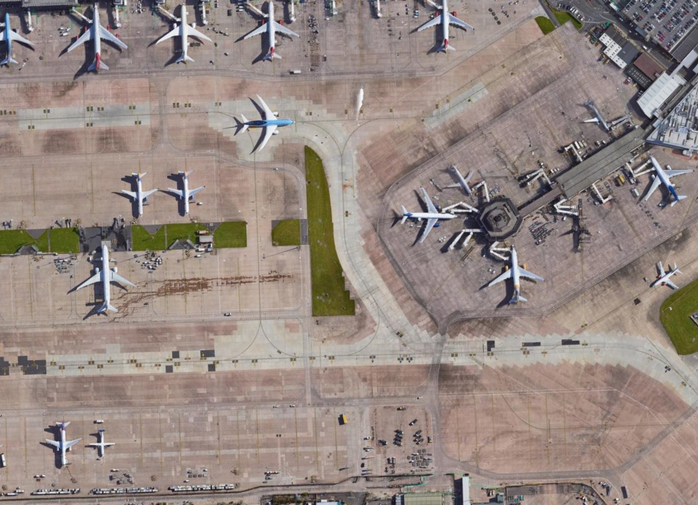

Rareplanes
Mimicking planes is simple as a copy and paste.
Notes:
A company called AI Reverie was looking for a way to classify airplanes from image data, in particular they were curious if there was a way to get more confidence classifying rare aircraft, that didn’t show up in training data.
One simple method of mimicking this data would be cutting and pasting existing planes in new locations. On the right here I have copied the large blue plane from the left hand image, and it is highlighted green on the right, and it’s copies are highlighted red. As we are the ones pasting these new planes in we could automatically tag these as more reliable data in our training set.
There are more complicated problems, which can’t be solved with this simple method for example
Dealing with shadows,
changing directions of planes,
And positioning planes only in locations where planes are allowed, for example there should be no planes on top of other planes.
This is where simulation can come in handy.
Image source Google Earth

Slide 44
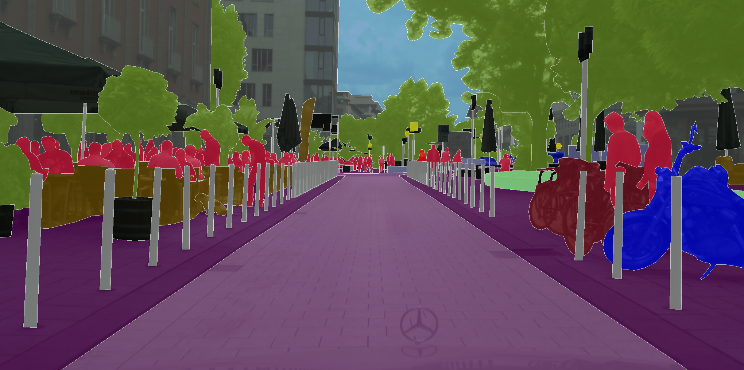
Photo Realism
Cityscapes dataset
Tagged people, cars, bridges, roads and more
Notes:
Another example is the cityscapes dataset, this is a large dataset of image data around Germany with tagged pixels relating to people, bikes, poles, trees and more.
A lot of manual effort has gone in to collecting these 25,000 well segmented images across germany. To enhance this dataset we need a system where we can automatically not only create new scenes, but reliably tag these scenes.
https://www.cityscapes-dataset.com/examples/

Slide 45
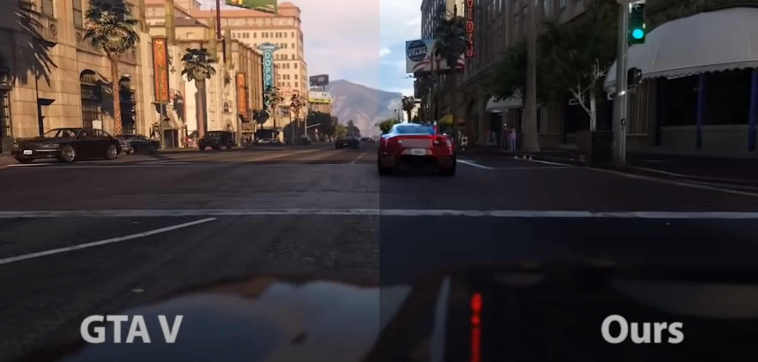
Video games as simulation
Video game engines automate labelling.
GTA V is being used in research.
Notes:
This tagging is already solved in video games with very impressive graphic systems. When video games render scenes they already have materials and entities labeled as cars, people, trees matching this dataset.
Grand Theft Auto 5 is frequently being used in research, in particular Intel released a study where they used training data from this game to improve their model as it was easier than manually collecting and tagging images.
Yes, these graphics aren’t photorealistic, but in almost all computational models in some regard our data isn’t perfect.
https://www.cityscapes-dataset.com/examples/

Slide 46
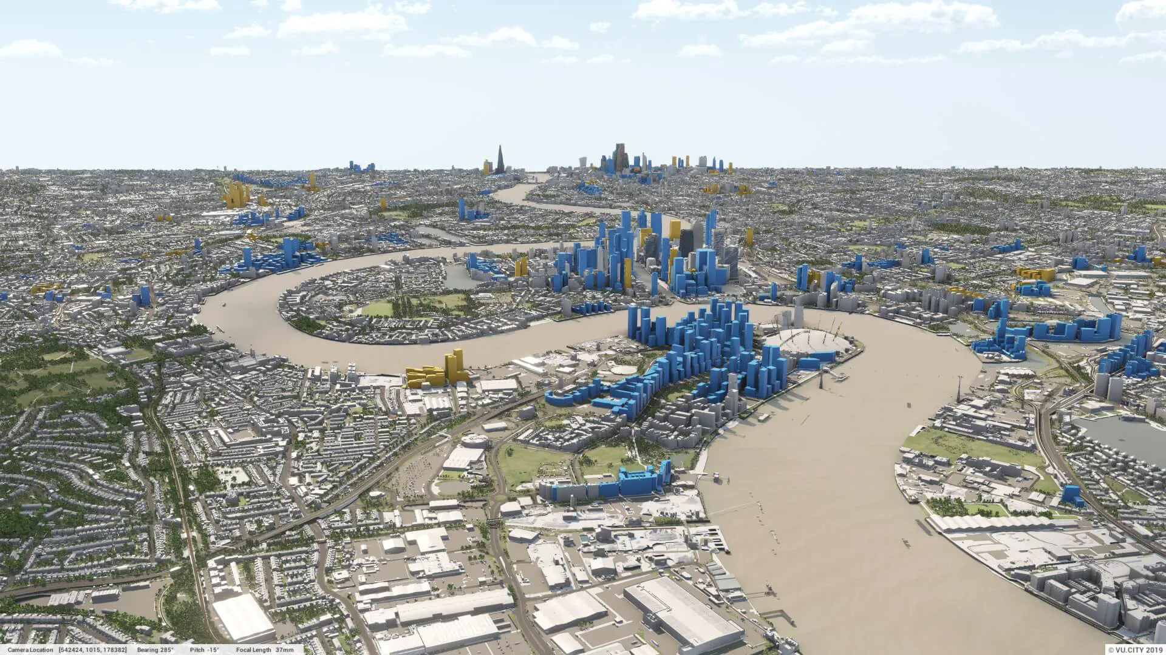
Digital Twin London
Cities worldwide are creating digital twin cities.
Test policy changes.
Measure the impact of a new build.
Notes:
As this technology becomes more common it is becoming essential in use in the development of councils, cities and countries worldwide.
New buildings can be added to a city, with their impact on daylight, pedestrian foot traffic, street traffic and more.

Slide 47

Poll
1001 Pawing avenue from 66 Pawing avenue, is that:
Coarsening?
Simulation?
Mimicking?
Notes:
If we create the record 1001 Pawing avenue from 66 Pawing avenue is that
Coarsening
Simulation
Mimicking
WAIT FOR POLL
Speculate on results,
It’s not really coarsening because we aren’t directly reducing the precision of anything, perhaps we could argue that by using a nonsensically large 1001 we are flagging this as not real, but the street name is the same. I think this is a stretch.
Simulation makes sense to me, a model could realistically generate a combination of random numbers and street name pairs, though these simulations may learn to use street numbers that statistically don’t show up. How many streets do you know that go up to 1000 for example.
It could also be mimicking, we don’t really know. If this record sampled our data and added some noise to the number this could be true too. I would argue it’s a large amount of noise to add though. In reality this could be considered a combination of sampled street addresses with simulation randomly generating numbers.
Again this is all purely a matter of semantics, these disclosure control methods don’t really call for a classification in common use.

Slide 48
ONS Synthetic Data
Notes:
And finally, it’s time to put the pieces together.
Next we walk through the Office of National Statistics Synthetic data report.
Here we can summarize how we determine what tools and types of synthetic data that are appropriate.

Slide 49
ONS Synthetic data spectrum
Notes:
We looked at this diagram before, but there are explicit definitions of what these different types of synthetic data are, and depending on which one we need affects our next steps.
In this ONS definition, synthetic datasets are only suitable for code testing, with no desire to preserve underlying relationships. The more we try to preserve the underlying distributions the higher the disclosure risk of this data becomes.
It is expected that synthetic data does not have any disclosure risk, which is why this ONS paper deviates from the term synthetic data. Synthesis on it’s own has no guarantee for confidentiality. This is why the later part of this spectrum is referred to as a synthetically-augmented dataset.

Slide 50
Synthetic Data - Structural
Preserves only the format, and data type.
Contains only values present in the original data.
Based on available metadata.
To be used for very basic code testing. No disclosure risk or analytic value.
age | first_name | occupation | gender | city
77 | Dana | Student | male | Manchester
2 | Lindsy | Teacher | non-binary | Las Palmas
26 | Markos | Recruiter | female | Condoroma
Notes:
Structural synthetic data is data identical only in structure to the real dataset.
It preserves only the format and data types. Variable names should be identical.
There is no noise added or magic here, so if we had personal data here it would still be exposed.
Constructed based only on available meta-data such the mean age, knowing that a first name column exists, because of this there should be no disclosure risk as there shouldn’t be any private data in here.

Slide 51
Synthetic Data - Valid
All records make sense in isolation.
Constructed based on meta-data, but real distributions not matched.
Missing values, errors and inconsistencies introduced.
age | first_name | occupation | gender | city
12 | Dana |  | female | Manchester
35 | Lindsy | Teacher
26 | Markos | Recruiter | male | Condoroma
Notes:
Valid synthetic data Preserves the format and data types same as structural data did. The addition here is that all rows should make sense.
There shouldn’t be, for example, any employed infants, unless those employed infants existed in the original dataset. We don’t apply any rules or logic to try to protect against this.
We draw values from realistic sources, but make no attempt to copy their distributions, a 100 year old is no rarer than a 10 year old for example.
In this case i’ve adjusted genders and ages to match up with first_names and occupations for example. We also might encounter missing data, or spelling mistakes. Our 12 year old Dana, probably hasn’t filled in an occupation for example.

Slide 52
Synthetically-augmented - Plausible
Preserves format and record-level plausibility.
Values generated from observed distributions with noise, but no relationships preserved.
age | first_name | occupation | gender | city
83 | Boycie | Research Associate | Male | Kalianda
74 | Meier |  | Genderqueer | Borucin
32 | Antonina | Chief Design Engineer | Female | Las Mercedes
Notes:
Now we have synthetically-augmented, plausible data.
This data preserves the format and record-level plausibility as previous, and replicates distributions where possible.
This is our first dataset based on the real dataset, values are generated based on real observations but we add noise.
We also keep the frequency of any missing data, or mistakes.

Slide 53
Synthetically-augmented - Multivariate plausible
Preserve format and record-level plausibility and replicate relationships loosely.
Constructed based on the real dataset.
Missing values and their frequency preserved.
age | first_name | occupation | gender | city
83 | Boycie | Research Associate | Male | Kalianda
74 | Meier |  | Genderqueer | Borucin
32 | Antonina | Chief Design Engineer | Female | Las Mercedes
Notes:
The syntehtically augmented multivariate plausible data is identical to the previous form, but with the addition that we make effort to replicate the relationships between variables loosely. In the ONS paper this is described as only being applied to high-level geographies.
This means this dataset should have some inherent value from an analytic or machine learning perspective, but is only a low-level pass.
Visually this won’t really look different, but we might see that the average age people in Manchester to correlate with the real data.

Slide 54
Synthetically-augmented - Multivariate detailed
Same as the previous level, but effort made to match the real relationships, down to the full granularity of the data.
age | first_name | occupation | gender | city
83 | Boycie | Research Associate | Male | Kalianda
74 | Meier |  | Genderqueer | Borucin
32 | Antonina | Chief Design Engineer | Female | Las Mercedes
Notes:
Synthetically augmented multivariate detailed is Similar to the previous levels, but this time we attempt to match the granularity of our data.
Visually this won’t really look different, but we might see that the average age of a Male Research associate correlates in the same way it does in the real data.

Slide 55
Synthetically-augmented - Replica
Preserves the format, structure, distributions, quality and granularity of data.
Could be used in place of real data, high disclosure risk.
age | first_name | occupation | gender | city
83 | Boycie | Research Associate | Male | Kalianda
74 | Meier |  | Genderqueer | Borucin
32 | Antonina | Chief Design Engineer | Female | Las Mercedes
Notes:
Finally we have replica data.
This data is like the real data in almost every way, it preserves the format, structure, distributions, quality and full granularity of that data.
The purpose here is to use this data, instead of the real data, but it’s likely you would only get access to this data in a secure research facility.

Slide 56
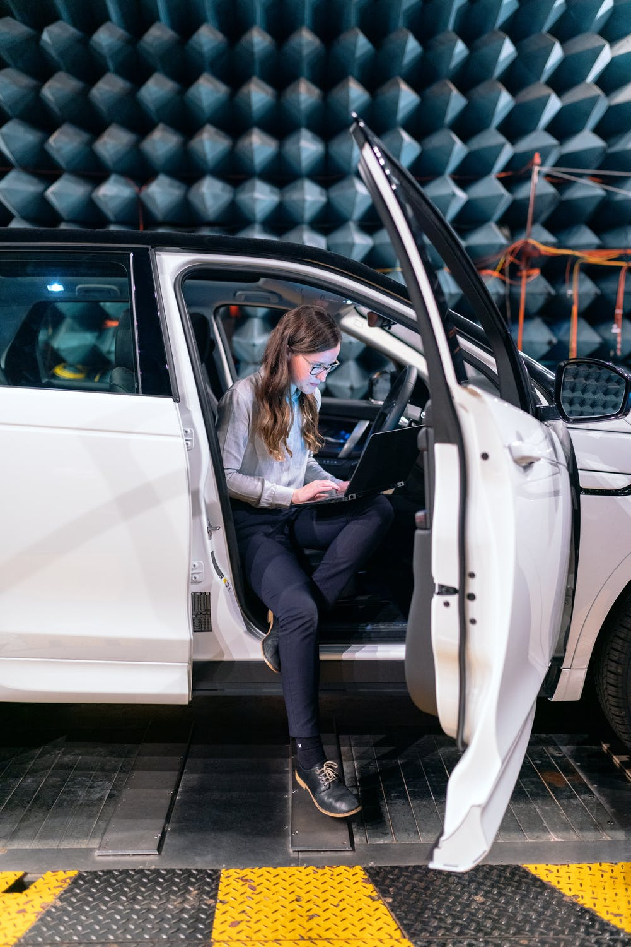
Recap
Synthetic data should represent extremes of the system
Synthetically-augmented datasets should represent the system and extremes if they show up.
Notes:
ONS expect that the data in this framework referred to as “synthetic data” is only going to be useful to testing code. I posit they have greater uses than this, for example showcasing a new open dataset or hiring staff with data that is in a familiar context.
In these cases you want data that represents the extremes of a system, you want the 100 year old user that might cause your 2-digit number column in a database to crash.
Further to this, what they refer to as synthetically-augmented datasets pose analytic value, but again further to only analysis good synthetic data and methods such as oversampling can really enhance the predictive power of a machine learning model.
In these cases you want real representation, you don’t want the edge cases unless the edge cases indicate something interesting analytically, or are well represented in your dataset.
There is a little of wiggle room between these cases and that’s okay, again it’s not really a system we need to classify, but we do need to conform to some case-by-case data protection standards. We have to remember what the purpose of our synthetic data is, and hence what form of generation and detail is really appropriate.
Image Photo by ThisIsEngineering from Pexels

Slide 57
Poll – why might you use Synthetic Data?
I don’t think I will
Testing code?
Reproducible work?
Create training data?
Hire staff?
Notes:
So to wrap up this ONS recap, I want to ask you all why you think you might use synthetic data in your future
I don’t think I will
To test some code
To make some work more reproducible
To create training data to enhance a model
To create some data to use to hire staff

Slide 58
Tooling
Notes:
Next we will talk about some of the different, commonly used tools we have at our disposal.
The ONS link at the end of this presentation has an amazing comparison table that I recommend you look at.

Slide 59
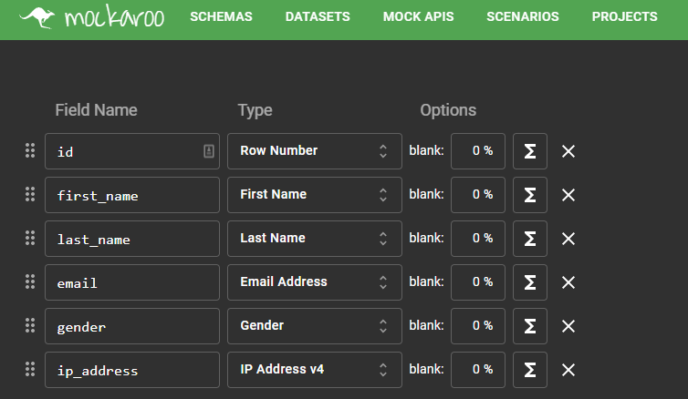
Tooling - Web-based
No need for programming knowledge.
Standard variables exist - age, city, NHS number.
Trivial simulation of missing data.
Custom logic difficult or impossible to implement.
Limited to 1000 rows of data.
Notes:
Web-based tools such as Mockaroo have come a long way in making a basic level of fake data creation available to users with no programming knowledge.
Standard variables already exist, such as names, emails, genders and cities.
We can add a percentage value to return missing data.
We can even represent complicated mathematical relationships such as plotting a normal distribution of ages in our dataset, but as we become more reliant on this custom logic we find this process tends to become as difficult as the programming solutions

Slide 60

Tooling - Faker
Knowledge of Python needed.
Generates fake identifiers - names, addresses, emails.
Supports multiple languages.
Addresses appear valid, but don’t exist
No way to preserve relationships between variables
Notes:
We have Faker, a Python package.
The primary purpose of this package is generating realistic data to test software, as such it prefers to generate structural over valid data.
it can generate fake identifiers, covering names, addresses, emails and more, in multiple languages.
At the surface these addresses appear valid, and conform to address rules with valid post code formats, but do not correspond to any real locations. This means that this is not appropriate for geographical studies.
There is also no way to preserve the relationships between variables.
This could be a very nice way to add non-identifiable data to outputs from more dangerous synthesis in a low-effort attempt at masking.
Image source - https://www.flickr.com/photos/appleboy/8679381967

Slide 61

Tooling - Synthpop
Knowledge of R needed
Once a model is fitted, producing a huge number of records is possible.
Built-in disclosure control methods.
Limited functionality for free-text.
Notes:
Synthpop allows R users to synthesise data from an existing dataset.
Values are populated using sampling and replacement, and eventually machine learning algorithms are applied to maintain relationships between fields. We can even control which algorithms are used.
There are built in disclosure control methods to remove unique records in the synthetic dataset that represent real records in the original dataset.
As with most machine learning, we are prone to over-fitting on this data and as the number of variables increases the training and accuracy becomes weaker.
Finally there is limited functionality to dealing with text, we add no noise to text data and cannot generate new realistic names or freetext.
If you are confident with R give this one a go it looks very cool! There are also packages SimPop and sms that do similar things.
Synthpop logo source
https://www.synthpop.org.uk/get-started.html

Slide 62
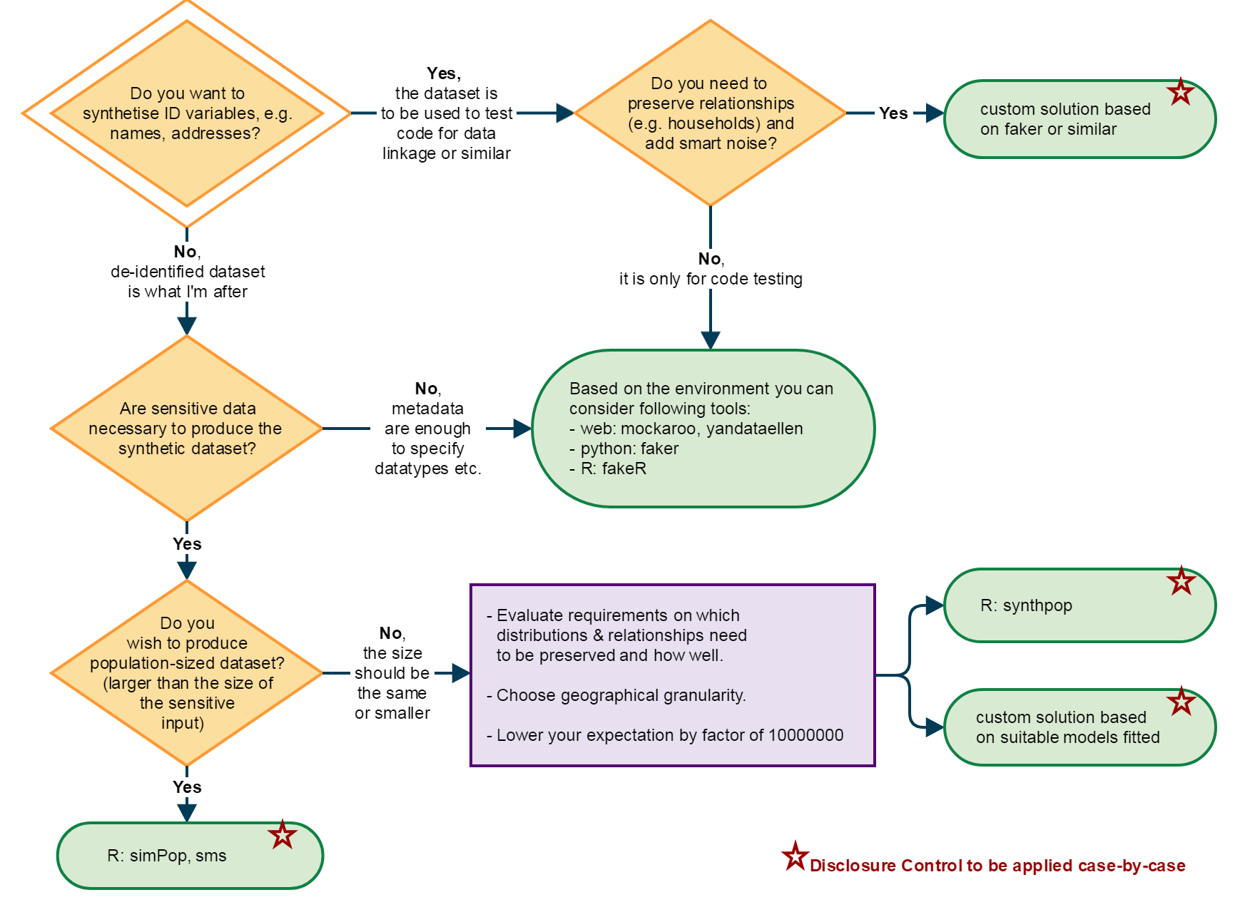
What should I use?
Notes:
Again, if we aren’t sure what software is the right fit for our needs the brilliant ONS have again provided a flowchart to make a tech decision for us.
Generally, if we want to generate datasets to use in testing, showcasing or recruitment we can use mockaroo or Faker.
If we need to preserve the relationships, and make use of sensitive data we should make use of these advanced R packages, simPop, sms and synthpop.
If we are getting any more complicated than that we might need to make use of our own custom solution joining these options with more advanced tooling.

Slide 63

How do we synthesize? - Step 1
Choose a dataset to synthesize.
Highlight the purpose of this data.
Notes:
Finally let’s break down the process of “how we synthesize”
Before we can get started we need a source of data, or at least an understanding of the structure and metadata.
We also need to determine the purpose of our synthesis, if it’s purely for testing code we can cut a lot of corners.
Photo by Andres Ayrton from Pexels

Slide 64

How do we synthesize? - Step 2
Familiarise yourself with the data.
Determine the most important variables to your purpose.
Notes:
Next it is time for some exploratory data analysis,
Dive into your dataset and assess the quality of your data
Get an understanding for what this data shows, and how we could make use of it.
You might find that you only need a few columns to make most of the use of this data, simplifying before synthesis will save us a lot of work.
Photo by Vitaly Vlasov from Pexels

Slide 65
How do we synthesize? - Step 3
Select high priority variables.
Summarise low-priority variables.
Try to solve missing data.
Notes:
Select a small number of variables that seem to have the highest prediction power.
You may find close correlation between some other variables, for example age may correlate tightly with birthdate and marital status, so maybe we can get away with only using age.
If there is a lot of missing data, could we use the missing data itself as a feature? Could we impute around this missing data?

Slide 66
How do we synthesize? - Step 4
Try Synthesis
Notes:
At this point, we should have a dataset we are ready to hand into a synthpop model
Photo by InstaWalli from Pexels

Slide 67

How do we synthesize? - Step 5
Verify results
Pick a small test case
Notes:
And finally, check if things look okay.
Do synthesized rows appear to match the structure of our original data?
Have the correlations between values remained similar, is it good enough?
Could we add noise, or disclosure control methods to this to bring us closer to a deidentified dataset.
Photo by fotografierende from Pexels

Slide 68
Conclusion – Disclosure Control
Coarsening is a practical way of reducing the granularity of a dataset.
Mimicking is a good way to grow our data, but does nothing for confidentiality.
Simulation gives us a way to create more data, and provide confidentiality, but it’s complicated.
Notes:
So to conclude these webinars
We have seen coarsening is a practical way of reducing the granularity of a dataset, especially with concern to geographic data.
Mimicking is a great, and easy way to increase the size of our dataset, but we are essentially creating random clusters around existing and personal data.
Simulation is the method of creating new data, it solves the problems of mimicking but it requires some tech skills and time invested.

Slide 69
Conclusion – Synthetic data
The better our synthesis, the more analytic value, the more disclosure risk.
Use Mockaroo or Faker for purposes that aren’t concerned with personal data.
Use Synthpop, Simpop or sms for purposes that require realistic data.
Notes:
The better our synthetic data, the more analytic value it has, but also the more risky that data can become.
If you aren’t worried about personal data in your dataset, or need something to test code or showcase use Mockaroo or Faker.
If you need data that is useful from an analytic of predictive perspective make use of R and it’s data generation libraries, Synthpop looks very cool!

Slide 70

Next time on Synthetic Data
Code Demo!
Notes:
So there will be a break between now and the code demo, but join us in two weeks where we will actually try to synthesize some data and make use of these packages.
Photo by Pixabay from Pexels

Slide 71
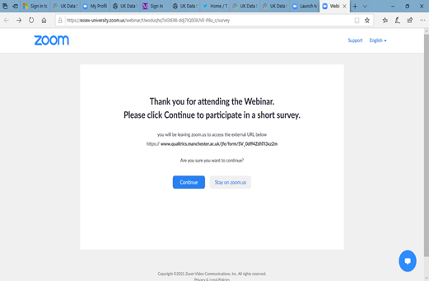
Evaluation
When you leave the webinar, please complete our short Qualtrics survey.
Click on ‘continue’ to access the survey.
Notes:
After this webinar ends you should see a prompt to leave some feedback, please go through this short survey as it helps us make better webinars for you!

Slide 72
Further Reading
Data in Government Blog tinyurl.com/Synth-DataInGov
ONS Synthetic data pilot https://www.ons.gov.uk/methodology/methodologicalpublications/generalmethodology/onsworkingpaperseries/onsmethodologyworkingpaperseriesnumber16syntheticdatapilot
Notes:
If what you just heard interests you here are some further readings
The data in government blog categorises and explains some different methods of data synthesis.
The ONS synthetic data pilot is the level of depth I wish i’d seen from all synthetic data resources. And inspired this whole webinar!

Slide 73
Further Reading - Simulations
Rareplanes medium.com/the-downlinq/rareplanes-exploring-the-value-of-synthetic-data-part-1-29f0a674054b
Enhancing photorealism Enhancement www.youtube.com/watch?v=P1IcaBn3ej0
Evolution of trust https://ncase.me/trust/
Notes:
There are also links for all the simulation demos we discussed
Rareplanes is a dataset of synthetic airport photos, with tagged airplanes.
Enhancing photorealism was the study that used data from video games
Evolution of trust is a wonderful walk through the prisonners dilemma.

Slide 74
Further Reading - Tooling
Mockaroo www.mockaroo.com
SynthPop www.synthpop.org.uk/get-started.html
Faker www.faker.readthedocs.io
Notes:
And finally the links to our tools
Mockaroo
SynthPop
Faker

Slide 75
Twitter @JosephAllen1234
Joseph Allen
Email Joseph.allen@manchester.ac.uk
Notes:
Thanks everyone and please feel free to start asking any questions now, I will have a look through the Q&A tab shortly.
If you have any thoughts that come after this talk, or you’re watching the recording on YouTube feel free to message me on my Twitter or email me at joseph.allen@manchester.ac.uk.

